Slide 1
Vocation and the Christian Life: Call, Grace, Sacrifice

Slide 2
What is a Vocation?
Priesthood only?
State in Life Only? (Married/Single)
A Job or Career Only?

Slide 3
Part of a Bigger Plan
God is a personal, loving Father Creator who has a plan for our life…
Universal Call to Holiness. Eph 1:1-10
To be set apart for a sacred purpose.
“Chosen before the foundation of the world to be holy and without blemish”
“To be adopted into the family of God”

Slide 4
Defining Terms
Vocation: vo·ca·tion
noun \vō-ˈkā-shən\
Definition of VOCATION
1:a: a summons or strong inclination to a particular state or course of action; especially: a divine call to the religious life b: an entry into the priesthood or a religious order c. marriage d.single
2:a: the work in which a person is employed: occupation b: the persons engaged in a particular occupation

Slide 5
Source of Call: Authority and Other
Root of Vocation:
Latin-Vocatio (Summons)
Latin-Vocare (to call)
Authentic vocations always come from outside. Their source is God calling as an authoritative Other.

Slide 6
Three Parts…
Every vocation has three essential parts…
Call
Grace given
Sacrifice
Carravagio’s Three Paintings of St. Matthew: The Calling of St. Matthew, The Inspiration of St. Matthew, The Martyrdom of St. Matthew
1599-1602 Contarelli Chapel, Rome.

Slide 7
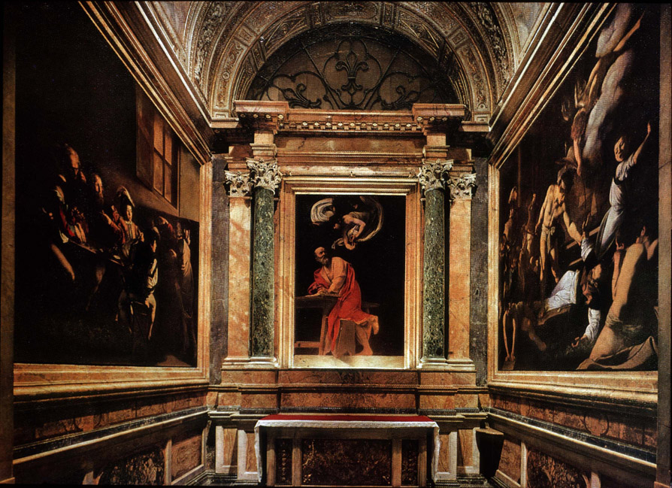
Call
Grace Given
Sacrifice

Slide 8
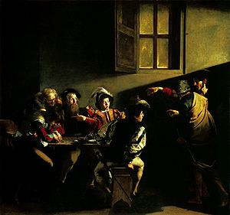
Call

Slide 9
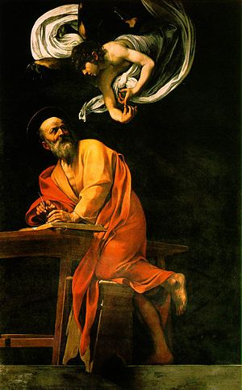
Grace

Slide 10
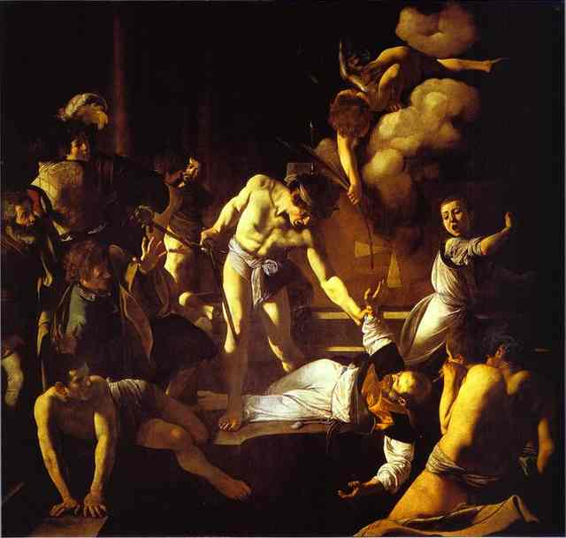
Sacrifice

Slide 12
12 Signs that it is God calling…
1. God is experienced as authoritative other. (Matthew, Samuel, Moses, Abraham)
2. Happens at night or other times that encompass silence and solitude. At night senses are winding down lack of light, lack of noise. Also, the person is in an introspective/reflective mode. (Samuel)
3. The call is based on the natural gifts that the person is born with. Grace perfects nature. We are created with an end in mind.(St. Paul)
4. The person experiences self-doubt/humility in response.(Moses, Peter)

Slide 13
5. The call involves difficulty, sacrifice. This affords one the opportunity to enter into an agape quality of love.(St. Paul, all Apostles, martyrs, everyone)
6. The call involves separation. Either actual travel (Abraham, Moses) or separation from your comfort zone. (Bilbo)
7. God uses your surroundings, experiences and others to persist in His call.(Fr. Steve)
8. God gives a sign that the call is authentic and that the person is on the right track in responding. A number of "Divine Coincidences".(Joseph, St. Joseph)

Slide 14
9. God doesn't call the qualified. He qualifies the called. The people called to greatness start out as unlikely, lowly people.(David, Matthew, Peter)
10. Results of responding to God's call lead to extreme inner peace, happiness in spite of sacrifices (Job, Mary)
11. Vocations are a call to a Great Adventure. Never Boring.
12. Starting out as enemies. Conversion.(St. Paul)

Slide 15
Sacraments of Vocation/Service
Holy Matrimony and Holy Orders
Why ‘Holy’?

