Slide 1
In a Parallel Universe
By Eli Rezkallah

Slide 2
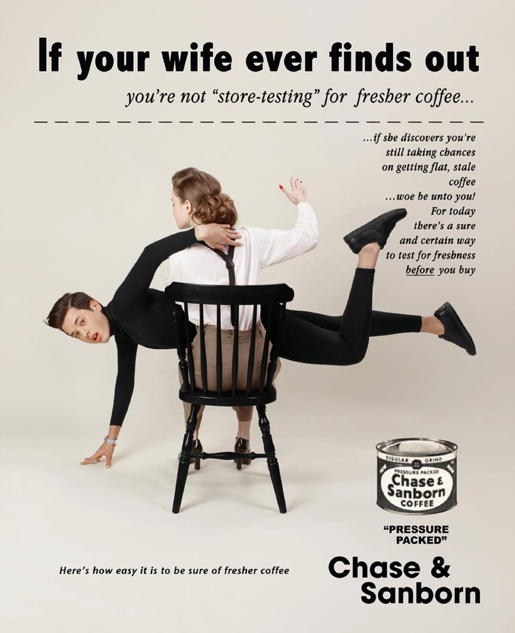

Slide 3
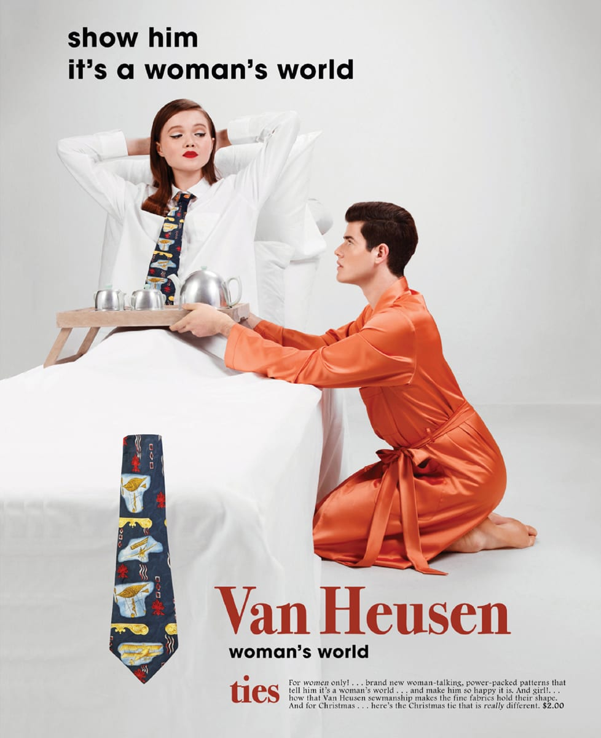

Slide 5
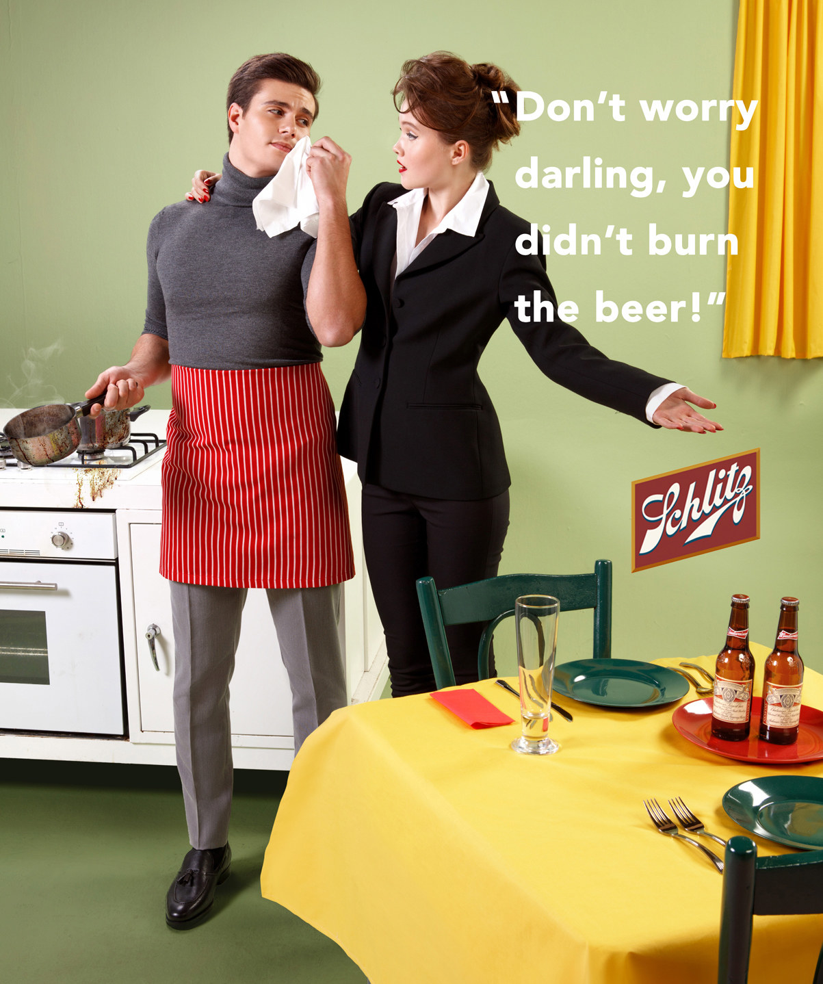

Slide 6
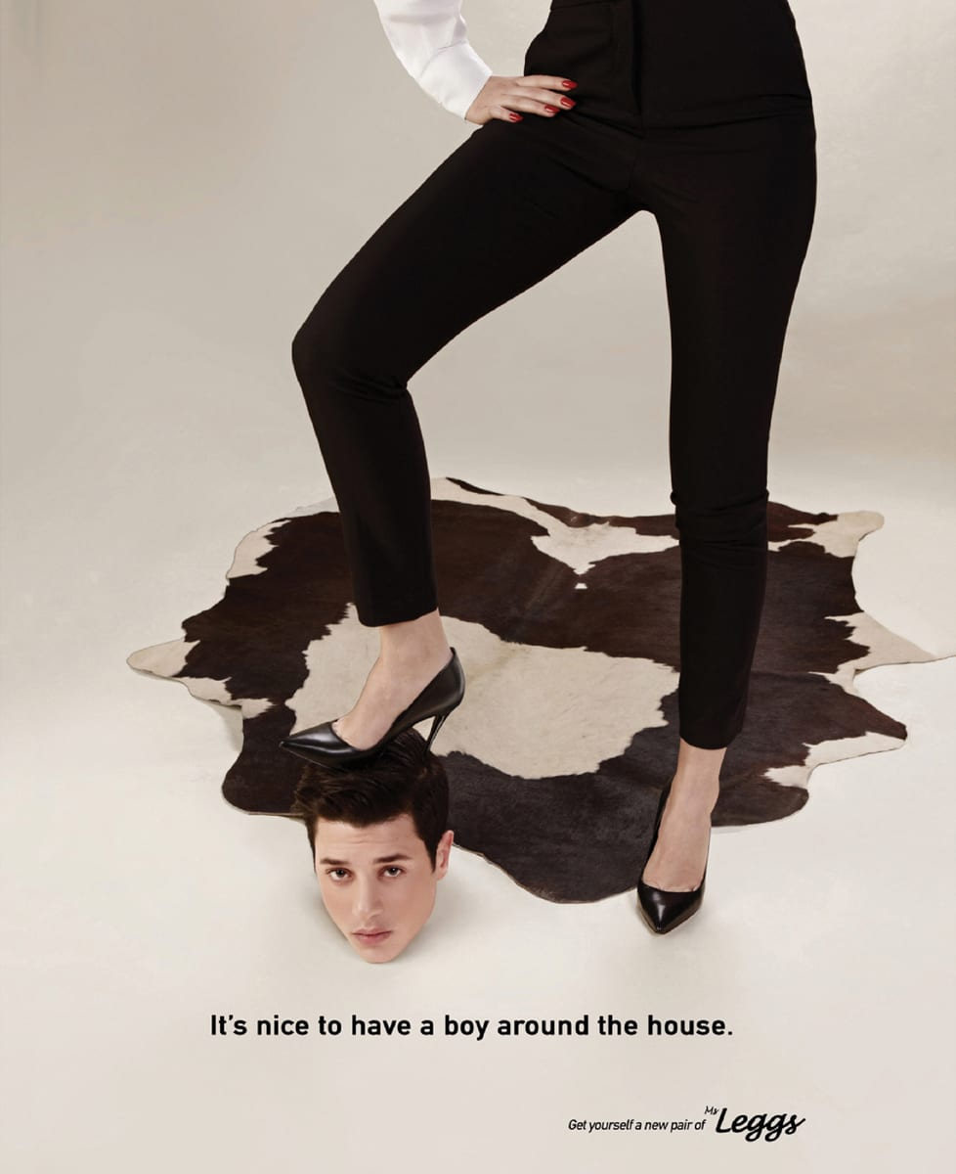

Slide 7
How do these images make you feel?
Write a paragraph about the reaction you have to these images of men being subjugated.
Do they bother you? Why or why not?
Are they demeaning/disparaging? How and why?

Slide 8
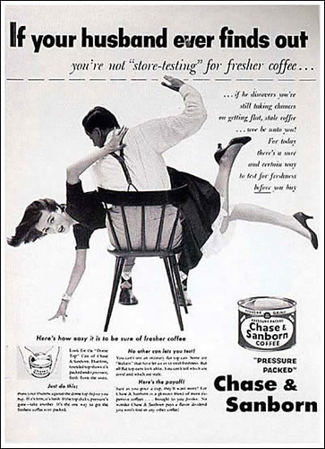

Slide 9
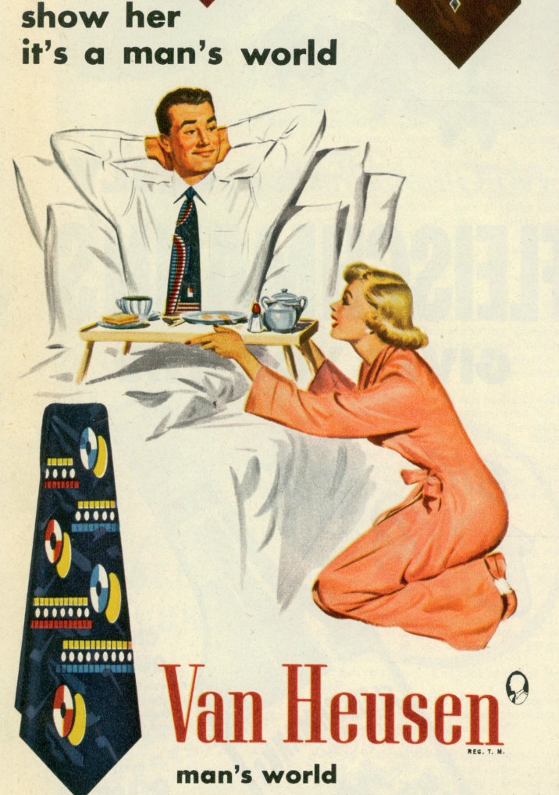

Slide 11
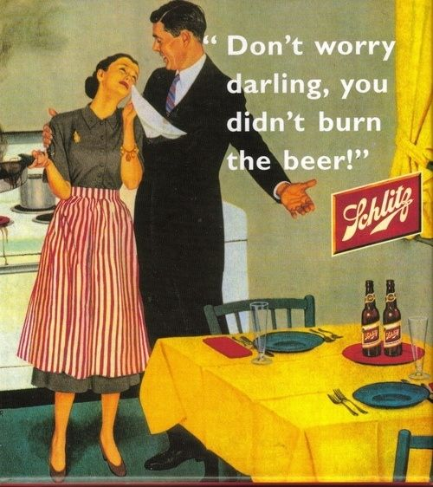

Slide 12
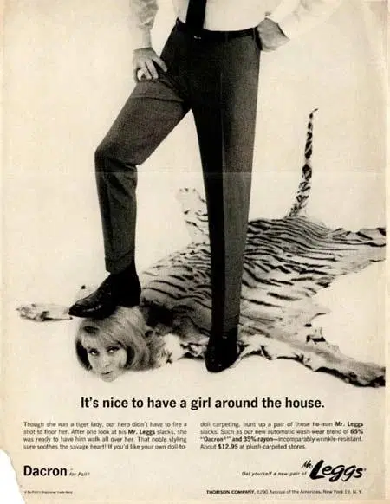

Slide 13
Visual literacy...
How do the images immediately illicit a reaction from the audience?
How do the words interact with the images?
How are formal features such as layout, fonts and visuals used to create an effect in these advertisements?

Slide 14
IB Connections
What global issues might be addressed through the ads? Through the modernization of the original ads?
In what ways might you use these ads/art in order to address an IB assessment? Which assessment could you use this for and how?

Slide 15
Your assignment:
With a partner:
1. Come up with 2 global issues that could be addressed using these ads (think theme).
2. Pick one assessment that you could use this set of ads/art. How might you use these ads/art to answer/address the the assessment?

