Slide 1
How The Monks Saved Civilization
‘Seek ye first the Kingdom of heaven and all of these things will be added unto you.’

Slide 2
200’s AD
Consecrated virgins: Women who lived lives of prayer and sacrifice
Looking after the poor and sick

Slide 3
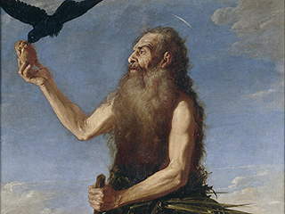
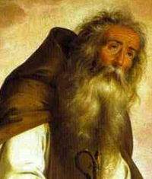
The Men
St. Paul of Thebes
St. Anthony of Egypt
-Sister became consecrated virgin
-he became a hermit in desert of Egypt
-pursued spiritual perfection (attracted many to him)
On Jan. 15, the Catholic Church remembers Saint Paul of Thebes

Slide 4
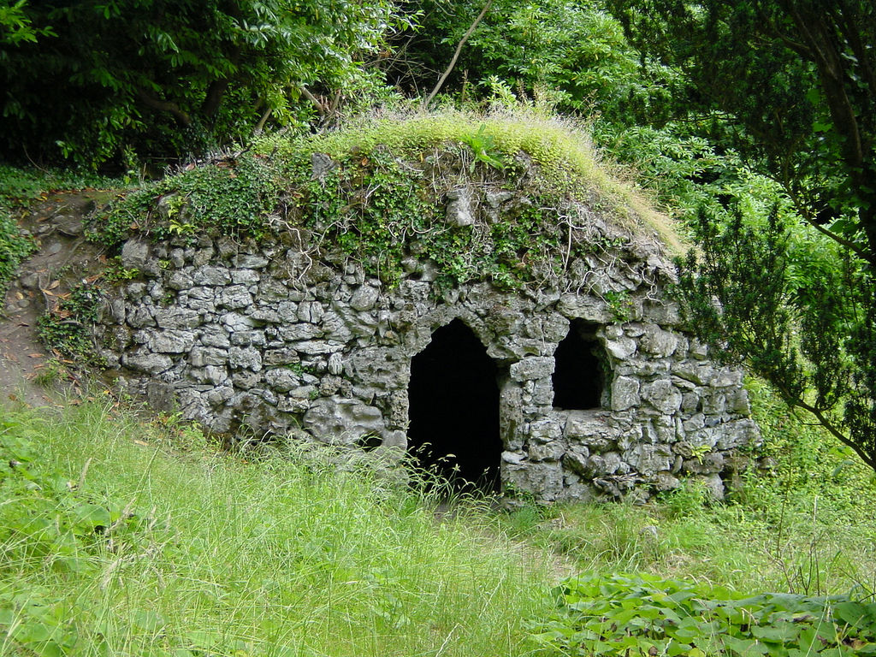
Life of a Hermit
Retreat into remote solitude
Renounce detach from worldly things
Concentrate intensely on spiritual life
Lived alone in caves/huts. Basket weaving
Lack of oversight by Church hierarchy led to some strange practices

Slide 5
Monasticism
Monks living in community
Reaction against the Hermit life-men ought to live in community
East-St. Basil the Great, West-St. Benedict of Nursia

Slide 6
St. Benedict
The rule-529AD: provided organization, structure and order. Moderation.
Adequate food and sleep
Each Benedictine monastery was independently run by an abbot
Monks did not roam-attached to their monastery
Abbot treated all equal-God is no respecter of persons

Slide 8
Barbarian Invasion:Turmoil
Benedictine monks endured
Remained an oasis of order and peace

Slide 9
Resilience of Monte Casino
Mother House of the Benedictines
St. Benedict himself founded it
Sacked by barbarian Lombards in 589
Destroyed by the Saracenes in 884
Razed by an earthquake in 1349
Pillaged by the French in 1799
Bombed during WWII 1944
Each time the monks returned and rebuilt!

Slide 10
Benedictine Achievement
By beginning of 4th century the order had supplied the Church with 24 popes, 200 cardinals, 7000 archbishops, 15,000 bishops and 1500 canonized Saints.
At its height the Benedictines had 37,000 monasteries
Notes:
And it was not

Slide 11
The Practical Arts
Agriculture: saved it, practiced it under untried conditions
‘We owe the agricultural restoration of a great part of Europe to the monks’
Converted wilderness into cultivated land, bred cattle, cleared morasses (swamps)
“Every Benedictine monastery was an agricultural college for the whole region it was located in”
The monks embraced hard work, manual labor as a spiritual penance/test

Slide 12
Swamps
Most of the land that the monks occupied was at first forests and swamps.
Most secluded and inaccessible sites-to reinforce communal solitude
Bad land was donated to them
The monks were the 1st to dike and drain swamps turning what was a source of disease and filth into fertile agricultural land.
Also the monks planted trees and conserved forests when possible.

Slide 13
Before
After

Slide 14
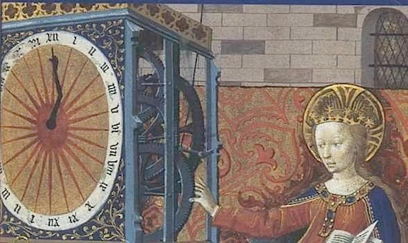
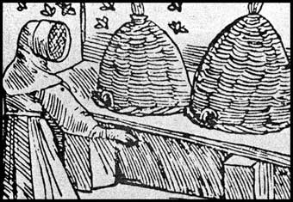
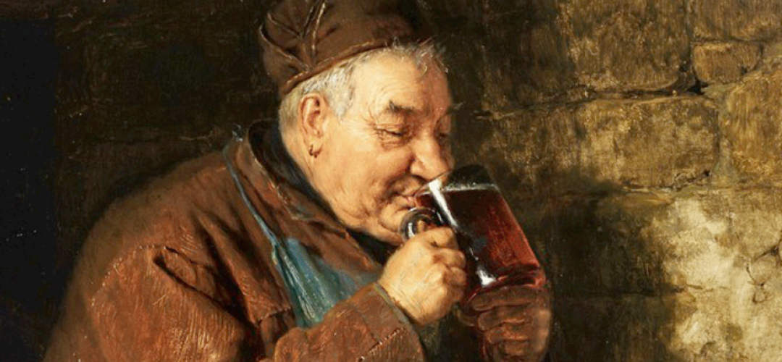
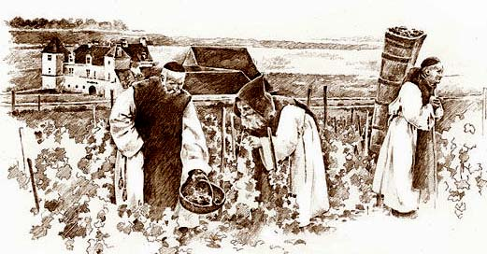
Beyond Agriculture
They introduced people to the rearing of cattle and horses: methods improved breeding
Brewing of beer
Bee keeping, fruit trees
Sweden-Corn trade
Parma-Cheese making
Ireland-Salmon fisheries
Clock making
All over-The finest vineyards/wine champagne
Irrigation-redirecting water

Slide 15
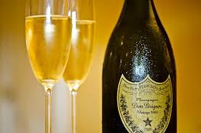
Dom Perignon
Benedictine monk at St. Peter’s Abbey
Appointed cellarer of the abbey in 1688
Developed champagne by blending wines
Same principles used today

Slide 16
Monks architects of medieval technology
The Cistercians employed water power
Factory with water power to operate machinery
Crushing wheat
Sieving flour
Fulling cloth
Tanning hides

Slide 17
Metallurgy
From 13th to 17th century Cistercians were the leading iron producers in France
Used slag as fertilizer

Slide 18
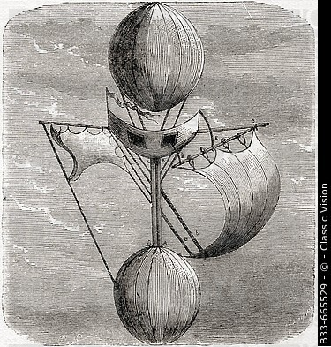
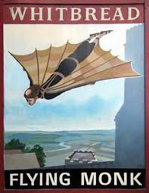
Flight
An early 11th century monk named Eilmer flew more than 600 ft. with a glider
Jesuit Fr. Frencesco Lana-Terzi (1670) called father of aviation wrote a book called, ‘Prodromo alla Arte Maestra’-1st to describe the geometry and physics of a flying vessel

Slide 19
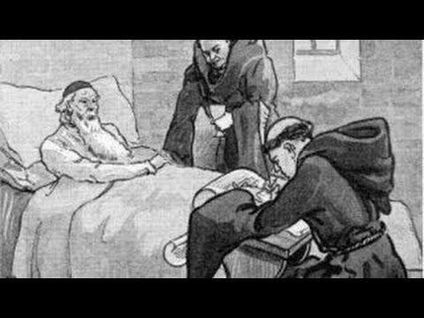
Charitable Works
Benedicts Rule: Monks must alms and hospitality, ‘All guests who come shall be received as though they were Christ’
Monasteries served as Inns: safe, peaceful resting place for foreigners, pilgrims, poor
Monastic hospital: the bell of the wanderers
Aid to shipwrecked
Roads/bridges in local communities

Slide 20
The Written Word
The Church cherished, preserved studied and taught the works of the ancients which otherwise would have been lost
The copyist: difficult demanding task
‘Though three fingers hold the pen, the whole body grows weary’

Slide 21
The Bible
Ancient Latin and Greek literature, books documents saved and transcribed, preserved
Works by Aristotle, Cicero, Pliny, and Virgil
These copyist became students and later great teachers of the classics and church fathers
-Numerous copies-survived onslaught of Barbarians
Decorated gospels with art

Slide 22
Pope Victor III 1086
Described as the greatest of the Abbots of Monte Cassino after Benedict himself.
Studied and taught Horace, Sallust, Terence and virgil
Oversaw the transcription of Horace Seneca and Virgil

Slide 23
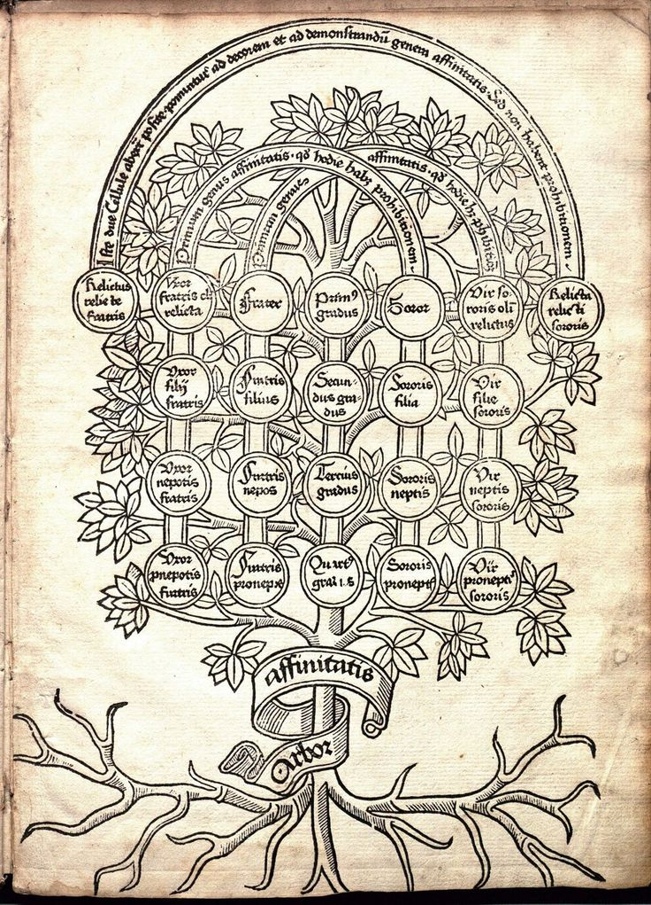
Branches of Knowledge
Gerbert of Aurillac (Pope Sylvester II)-Logic
The Monks of St. Benignus at Dijon-Medicine
Monastery of St. gall-painting, engraving
German monasteries- Greek, Hebrew and Arabic

Slide 24
Intellectuals
“Without study and without books”, said a monk of Muri, “The life of a monk is nothing”.
“Our books are our delight and our wealth in time of peace, our offensive and defensive arms in times of war, our food when we are hungry and our medicine when we are sick”.-St. Hugh of Lincoln

Slide 25
Education
Monks were teachers
As early as the 4th century it was a custom in Antioch to send sons to be educated by the monks
St. Benedict instructed the sons of Roman nobles
St. Boniface established a school at every monastery he founded in Germany
In England, St Augustine and his monks set up schools where ever they went
St. Patrick Irish monasteries became important centers for learning
Cathedral schools were established under Charlemagne

