Slide 1
Lumen Gentium

Slide 2
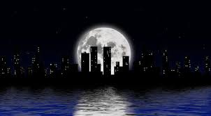
1 of 4 Major Documents from Vatican II
Lumen = Light
Gentium = Nations
“Light to the Nations”. Jesus As ‘sun’, church as ‘moon’. The Church is the Light to Nations but it’s source is Jesus Christ.

Slide 3
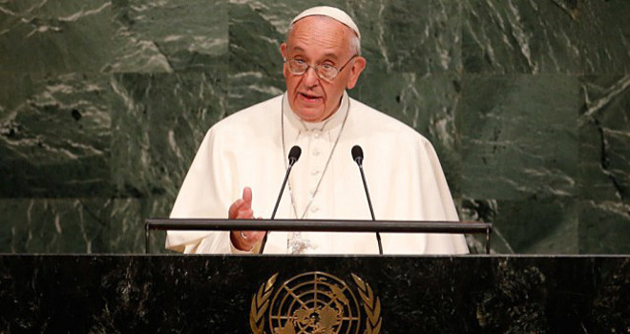
‘Vatican II’
The most recent Church council. (1962-65)
Named after the place it was held---
Vatican City is the smallest nation state, with it’s own flag, army, seat at UN and language. The pope is a National leader/head of State as well as Bishop of Rome.
Completion of Vat I (WW1 & WW2 got in the way)

Slide 4
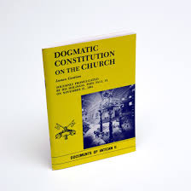
Dogmatic Constitutions
1. Dei Verbum (Word of God)
–On Divine Revelation
Bible,Tradition,Magisterium
2. Lumen Gentium (Light to Nations)
On Nature and Mission of Church
3. Sacrosanctum Concilium
On Liturgy and Sacraments
4. Guadium et Spes (Our Joy and our Hope)
On the Church in the Modern World

Slide 5
Lumen Gentium 8 Chapters…
Mystery of the Church
People of God
Hierarchy (Episcopate=Bishops/Pope)
Laity (baptized members )
Universal Call to Holiness
Religious
The Church in Heaven
Mary Our Mother

Slide 6
100 pt. Semester Project
8-9 Paragraph Report on ‘Lumen Gentium’ Due Mon. April 4.
-----------------------------
Size 12 font
Double space
Black ink
Times New Roman
------------------------
Take your summary sentences and create a paragraph that sums up that chapter in one page.
Use connector sentences to make it flow.
Each Paragraph due each Monday.(20pts)
(50pts)
Power point Presentation
You will be assigned one chapter to present.
You will be given a guideline when I assign your group.
5 slides/one per guy
Google Docs
8 groups(presentations) total (April 7-8 block and April 14-15 block.)
(50 pts)

Slide 7
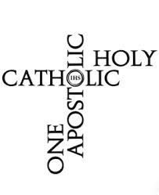
The Nature and Mission of the Church
Marks (Descriptive)
One
Holy
Catholic
Apostolic
Models (Allegorical)
Institution
Community
Sacrament
Herald
Servant
Pilgrim people
People of God
Temple
Body of Christ
Bride of Christ
Mother of Christians

Slide 8
Church as Mystery
Church, like Christ is human and divine.
The Church is a ‘hospital for sinners’
Both light and dark, The net contains a variety.
Holy Spirit animates the Church as a soul to a body
2000+ years with very colorful characters and turbulence- proof of Holy Spirit’s protection
Promises of Christ
The church is always changing—It’s a living body
The church is slow: proposes message vs. imposes
No one Model or Mark can capture the whole

Slide 9
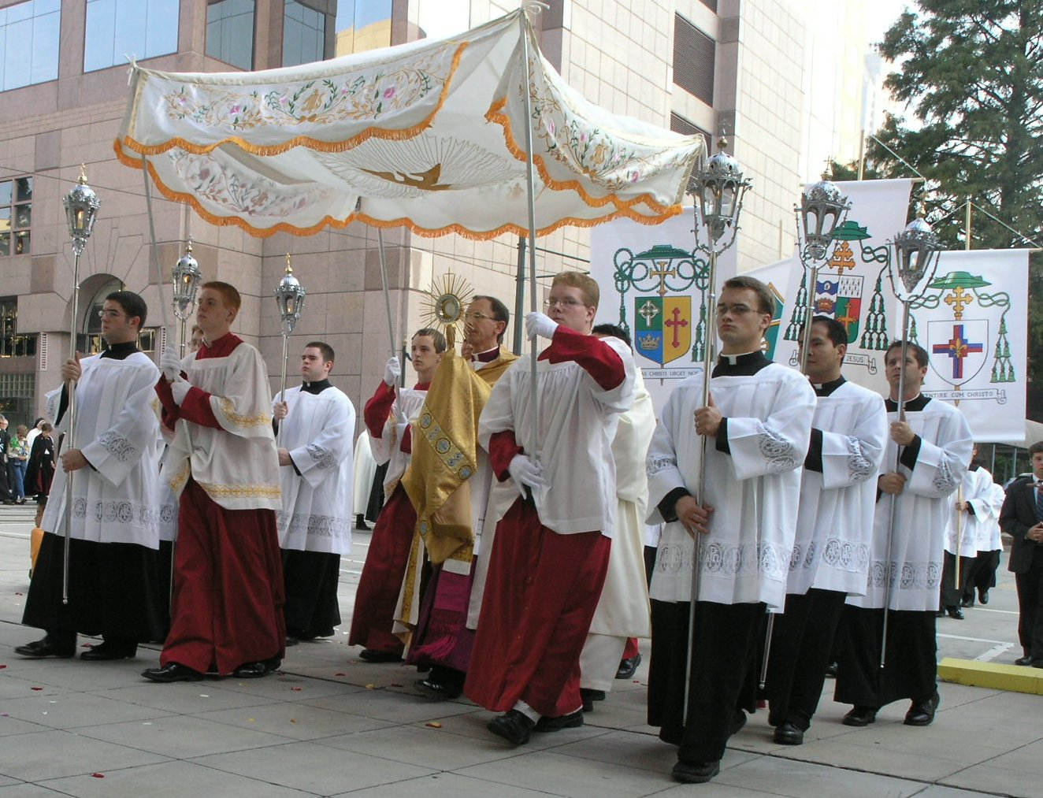
Institution
The Church is Visible and Hierarchical
Organization and Government
Physical Places: Cathedrals, Basilicas & Parish Churches with Art/Architecture
Bible, catechism, church docs
Rituals/Ceremonies
Clerical Garb

Slide 10
Institution: an established organization
The church the oldest institution on earth
There are an estimated 1.2 billion Roman Catholics in the world
More than 40% of the world's Catholics live in Latin America - but Africa has seen the biggest growth in Catholic congregations in recent years.
Records of Sacraments better than most govs.-Geneology
The human dimension
Both saints and sinners
Deacons
Religious
Lay people

Slide 11
Body of Christ
St. Paul’s favorite model
“Though many parts we are one body” 1 Cor.
“We were all baptized into one body” 1 Cor.
“For Christ is head of the body-church” Eph.
“I am Christ whom you persecute” Acts.

Slide 12
Body of Christ
Our suffering, prayers and sins affect the whole body
For Catholics it’s never just ‘me, my bible and God’---Rather… ‘We are all in it together’
Christ’s bodies…
Historical
Resurrected
Eucharistic
Mystical

Slide 13
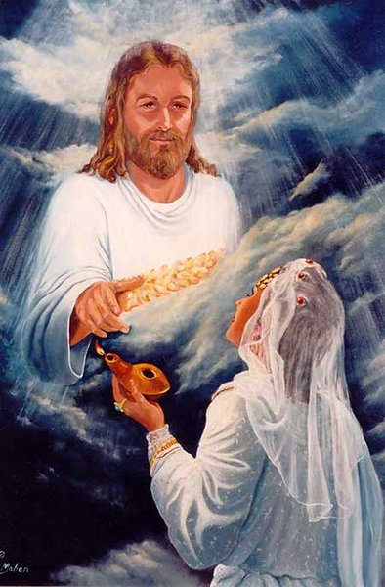
Bride of Christ: theme of whole bible
Genesis:
‘At last this one is bone of my bone, flesh of my flesh’
Song of Songs
Eros/Agape
Gospels
Jesus calls himself ‘the groom of the bride’
Bride of Christ built up from Jesus’ side
Ephesians ch 5
Wives/husbands =Christ/church
Revelation 21- 22:
And I saw the holy city, new Jerusalem, coming down out of heaven from God, made ready as a bride adorned for her husband.
“The Wedding Feast of the Lamb”

Slide 14
Eph 5: The Church is undergoing a transformation
‘Husbands, love your wives, just as Christ also loved the church and gave Himself up for her, so that He might sanctify her, having cleansed her by the washing of water with the word, that He might present to Himself the church in all her glory, having no spot or wrinkle or any such thing; but that she would be holy and blameless.’
Ugly Duckling
Cinderella

Slide 15
Community
Spiritual Support group
“We believe…”
Fellowship
Common lifestyles in a diverse culture
A sense of belonging
The tissue incident
The wine group

Slide 16
Sacrament
An outward, visible and powerful sign of an interior invisible Holy Grace.
Making God more present and active in the world.
Jesus as sacrament of Father, Church as sacrament of Christ.
-‘Whoever has seen me has seen the Father’

Slide 17
Church as Sacrament of Christ
A story is told that during the bombing of a city in World War II, a large statue of Jesus Christ was severely damaged. When the townspeople found the statue among the rubble, they mourned because it had been a beloved symbol of their faith and of God’s presence in their lives.
Experts were able to repair most of the statue, but its hands had been damaged so severely that they could not be restored. Some suggested that they hire a sculptor to make new hands, but others wanted to leave it as it was—a permanent reminder of the tragedy of war. Ultimately, the statue remained without hands. However, the people of the city added on the base of the statue of Jesus Christ a sign with these words: “You are my hands.”

Slide 18
Servant
Social Transformation
Serving those in need regardless of their identity
Hospitals/Schools/Charities
Church’s role as part of the human family.
‘Who is my neighbor?”

Slide 19
Herald
The Bible in liturgy
We hear the Word and are transformed by it.
The Good News of Salvation
‘Go and baptize all nations, teaching them everything I have given you”
Missionary effort: Spreading the Word, Gospel throughout the world
Angelic role

Slide 20
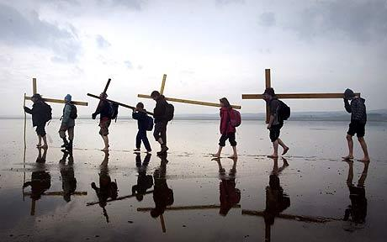
Pilgrim People
The Church is heading toward an end. (Telos)
The New Heaven, New Earth is our final home.
The Pilgrim Church on earth is only a small part of the whole
‘Communion of Saints’ is the three P’s: Pilgrimage, Purgation, Perfection
Part of the church has already arrived at the end (Perfection).

Slide 21
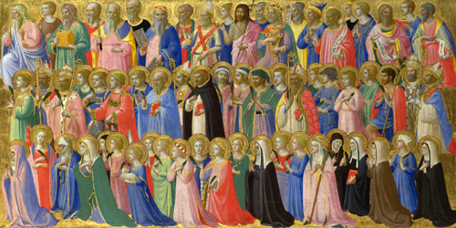
“Pilgrim Church: Walking with the Saints”
The communion of saints
We ask the saints to pray for us
The prayers of the righteous are very powerful
Family of God, Mary as mother Saints as brothers and sisters

Slide 22
Mother
Baptism is a Birth into a new life of grace
The church gives birth to her children from the womb of the baptismal font.
The church bathes, feeds, heals and teaches her children.
https://churchpop.com/2016/01/28/4-life-lessons-from-your-mom-that-you-need-for-your-spiritual-life/

Slide 23
Church as ‘Temple’
A place of prayer and sacrifice
A central gathering of the people of God
The strength and sturdiness of the church
Divine Dwelling Place: Holy Spirit dwells in it.
We , each are mini ‘temples’

Slide 24
People of God
Church as the New Israel
Not a replacement of the Jews but a fulfillment of the Promise God made to Abraham.

