Slide 1
Writing a Great Thesis Statement

Slide 2
What is a thesis statement?
Usually one sentence (but can be more) that explains why you are writing your essay
Usually comes at the end of your introduction
Main point of your essay
Clear, defined, personal point of view
Serves as the guideline for the rest of your essay

Slide 3
What can a thesis do?
Answers a question you have posed
Poses a solution for a problem you have identified
A statement that takes a position on a debatable topic

Slide 4
Thesis Examples
Prompt: Explain what pressures lead to the U.S. involvement in WWII.
Example thesis: In the 1940s there were a variety of pressures—political, cultural, and economic—that contributed to the U.S.’s ultimate decision to join the war.
Prompt: Is Harry Potter worthy of academic study, or is it just a children’s book?
Example thesis: The Harry Potter series should be taken seriously by academics, as it contains distinct character interactions, plot elements, and symbolic language that distinguishes it from books in the past.

Slide 5
A successful thesis…
Clearly makes an argument, explains a topic, and/or analyzes an issue.
Clearly presents your personal position.
Clearly limits the topic and scope of the essay.
Captures the readers’ interest.
Example thesis:
The Harry Potter series should be taken seriously by academics, as it contains distinct character interactions, plot elements, and symbolic language that distinguishes it from books in the past.

Slide 6
How to write a thesis statement:
Determine your topic.
What’s the general category of your essay?
State your position.
What is something about your topic that you believe to be true?
Give the reason for your position.
Why do you think your position is the correct one?
Put them together: Topic + Position + Reason = Thesis
Example thesis: The Harry Potter series should be taken seriously by academics, as it contains distinct character interactions, plot elements, and symbolic language that distinguishes it from books in the past.

Slide 7
Thesis don’ts:
Don’t announce your thesis: “Here’s what my essay is about…”
Don’t use only facts: “Smoking is bad for you.” (Doesn’t allow you to prove anything because it’s already factual)
Don’t use vague words: “good,” “bad,” “right,” “wrong.” (We want to get more specific.
Don’t use a question as a thesis: “Don’t you think people should stop eating meat?” (Does not give your specific viewpoint)

Slide 8
Make sure your thesis passes the “So What?” test!
If a reader is left thinking, “So what?” then you need to clarify, connect your thesis to a larger issue, or add detail to better take on your position.

Slide 9
Identifying thesis statements:
Prompt: What do we do about the energy crisis in America?
Response: Burning wood can supply energy, but there are not enough forests to meet demand. Oil has fulfilled society’s needs for nearly 100 years, but that resource is growing rare. As a result, oil prices are skyrocketing. Furthermore, many energy sources produce environment-killing CO₂. However, nuclear energy avoids the short-coming of all other energy sources. Nuclear power is the best form of energy as it is cheap, plentiful, and better for the environment.

Slide 10
Identifying thesis statements:
Prompt: What do we do about the energy crisis in America?
Response: Burning wood can supply energy, but there are not enough forests to meet demand. Oil has fulfilled society’s needs for nearly 100 years, but that resource is growing rare. As a result, oil prices are skyrocketing. Furthermore, many energy sources produce environment-killing CO₂. However, nuclear energy avoids the short-coming of all other energy sources. Nuclear power is most efficient form of energy as it is cheap, plentiful, and better for the environment.

Slide 11
Identifying thesis statements:
Prompt: Many people have argued that humans have ruined Earth and that space travel is the best hope for humanity’s survival. Do you agree with this? Why or why not?
Response: Life on Earth is bleak. Humanity has slowly and systematically destroyed the planet, ravaging Earth with wars, depleting the ozone layer and ruining farming soil, and killing plants and animals species forever. Most scientists agree that it is too late to reverse the damage done by humans to our planet, and the best humanity can hope for is to slow its death. It is too late to save earth; therefore, humans should begin planning relocation to Mars, where, with proper planning, they can solve the issues of famine, war, and global warming.

Slide 12
Identifying thesis statements:
Prompt: Many people have argued that humans have ruined Earth and that space travel is the best hope for humanity’s survival. Do you agree with this? Why or why not?
Response: Life on Earth is bleak. Humanity has slowly and systematically destroyed the planet, ravaging Earth with wars, depleting the ozone layer and ruining farming soil, and killing plants and animals species forever. Most scientists agree that it is too late to reverse the damage done by humans to our planet, and the best humanity can hope for is to slow its death. It is too late to save earth; therefore, humans should begin planning relocation to Mars, where, with proper planning, they can solve the issues of famine, war, and global warming.

Slide 13
Identifying thesis statements:
Prompt: The theme of fate arises many times in Romeo and Juliet. Analyze this theme.
Response: Shakespeare’s Romeo and Juliet is the tragic story of two star-crossed lovers. Doomed from the beginning, the play ends with both Romeo and Juliet dead. Through the foreshadowing element of the chorus, the characterization of Romeo and Juliet as young and naïve, and the situational irony of the final scene, the play reinforces the idea that individuals are powerless to change their fates. Shakespeare’s Romeo and Juliet thus serves as a reminder that the course of fate cannot be altered by hard work or cunning; we must accept our fate as is.

Slide 14
Identifying thesis statements:
Prompt: The theme of fate arises many times in Romeo and Juliet. Analyze this theme.
Response: Shakespeare’s Romeo and Juliet is the tragic story of two star-crossed lovers. Doomed from the beginning, the play ends with both Romeo and Juliet dead. Through the foreshadowing element of the chorus, the characterization of Romeo and Juliet as young and naïve, and the situational irony of the final scene, the play reinforces the idea that individuals are powerless to change their fates. Shakespeare’s Romeo and Juliet thus serves as a reminder that the course of fate cannot be altered by hard work or cunning; we must accept our fate as is.

Slide 15
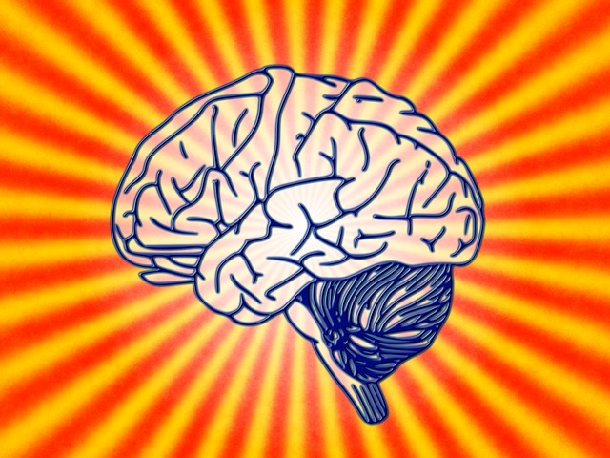
Remember…
Thesis writing is not formulaic, but is an art.
We write theses to understand what the central argument is.
We distill research and knowledge to make it palatable and simple.
You can always go back and revise your thesis!

Slide 16
Write a thesis statement:
TOPIC: Many people say that public schools are too crowded; however, others argue that large classrooms help students learn to collaborate. Should there be a limit to the number of students in a class?

Slide 17
A successful thesis…
Clearly makes an argument, explains a topic, and/or analyzes an issue.
Clearly presents your personal position.
Clearly limits the topic and scope of the essay.
Captures the readers’ interest.

Slide 18
Write a thesis statement:
TOPIC: Think on the saying, “Absence makes the heart grow fonder.” Do people need to spend less time with others in order to appreciate them?

Slide 19
A successful thesis…
Clearly makes an argument, explains a topic, and/or analyzes an issue.
Clearly presents your personal position.
Clearly limits the topic and scope of the essay.
Captures the readers’ interest.

