Slide 1
Sacraments of Initiation
Baptism: Born anew
Confirmation : Strengthened
Eucharist: Receive the food of eternal life
CCC 1212, “The faithful are born anew by Baptism, strengthened by the sacrament of Confirmation, and receive in the Eucharist the food of eternal life. By means of these sacraments of Christian initiation, they thus receive in increasing measure the treasures of the divine life and advance toward the perfection of charity."

Slide 2
Baptism
Baptize = Greek-’Baptizein’:
to plunge, immerse.

Slide 3
Spiritual Effect
Removes original and actual sin- CCC 1263, 1265
Causes a new birth, ‘a new creature’-CCC 1215, 1265
Incorporates into Christ’s death and resurrection-CCC 1214
Incorporates into the Body of Christ, the Church.-CCC 1267-1270
Is a source of spiritual enlightenment.
– CCC 1216
Opens door to other sacraments - CCC 1213

Slide 4
Adopted as sons and daughters of God- The Plan Eph 1:10- CCC 1265
Makes person ‘Temple’ of Holy Spirit.-CCC 1265
Reception of Theological Virtues –CCC 1266
Justification- CCC 1266
Leaves a spiritual mark called character, a permanent sign/mark of belonging to Christ. – CCC 1272-1274
Allows person to grow in goodness through the moral virtues. CCC 1266

Slide 5
Minister CCC 1256
Ordinary: a bishop, priest, deacon
Extraordinary: Any person if necessary(emergency)‏
Intention required

Slide 6
Form and Matter
Form- CCC 1240
“I baptize you in the name of the Father, The Son and the Holy Spirit”.
Matter- CCC 1239
Holy water
Pouring or immersion three times with each name of the Holy Trinity.

Slide 7
Required State
Unbaptized infant or Convert to Catholic Faith- CCC 1246 “Every person not yet baptized and only such a person is able to be baptized.”
From non-Christian background
Baptism is not repeated for those already baptized.
Validity of non-Catholic baptism recognized. CCC 1271

Slide 8
Preliminary Rituals
Sign of the Cross
CCC 1235
Proclamation of Word
CCC 1236
Exorcisms
CCC 1237
Blessing Water
CCC 1238

Slide 9
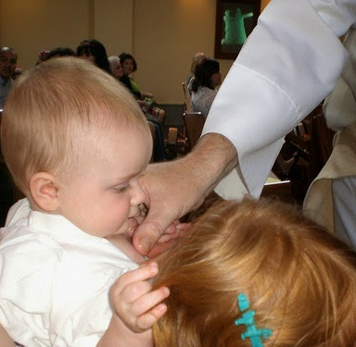
Anointing with Oil of Catechumens
1st anointing is on chest
This anointing is before the water rite
Signifies strengthening
Preparation for ‘spiritual warfare’
Part of ‘excorcism’

Slide 10
Water Rite: Rm 6,CCC 1239
Entering into water is entering into Christ’s death.
Coming out of water is rising with Christ in his resurrection.
3 steps into Baptismal font = 3 days in tomb.
Into tomb out of womb
The Church, as mother, gives birth to us in water
We become little ICHTHYS’s

Slide 11
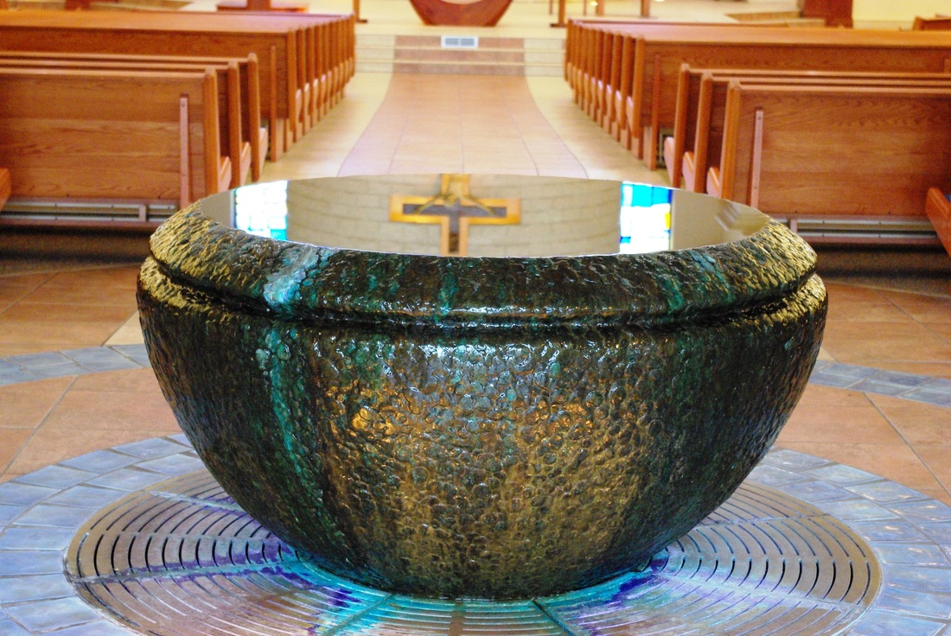
ICHTHYS
Ieous = Jesus
Christos = Christ
Theo Y ios =
Son of God
Soter = Savior

Slide 12
White Garment CCC 1243
White = Purity
Unstained robe
Clothed with Christ
“They have washed their robes and made them white in the blood of the Lamb”(Rev 7:14)‏

Slide 13
Anointing with Chrism CCC 1241
Done after water rite.
Chrism: Perfumed Oil used by Old Testament Liturgy
Signifies a new creation as…
Priest
Prophet
King(anointed on crown of head)‏

Slide 14
Lit Candle
Presented after water rite
The Candle represents the Light of Christ
Faith illumines the spiritual journey of the Baptized

Slide 15
Baptism Prefigured In O.T. CCC 1217-1222
Creation
Flood
Red Sea
Circumcision

Slide 16
Baptism in NT
John The Baptist - CCC 1223
Christ’s Baptism -Mt 3:13-17 CCC 1224-1225
Nicodemus-Jn 3:1-21
The Healing of the Man Born Blind –Jn 9:1-12
Baptism of Cornelius Acts 10:23-48
Baptism in the Church - CCC 1226, 1252
Necessity of Baptism- CCC 1257-1261

Slide 17
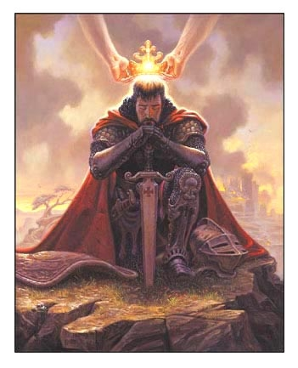
Confirmation

Slide 18
‘To Confirm’
con·firm
kənˈfərm/
verb
1. To strengthen.
2. To verify as being true, real.

Slide 19
Spiritual Effect CCC 1302-1305
Gives us special strength to …
Spread, defend the Faith by word and action as true witnesses of Christ
To profess the name of Christ boldly
And never be ashamed of the cross
The full outpouring of the Holy Spirit as once granted at Pentecost.
Increases and deepens baptismal grace
Unites us more firmly to Christ and Church
Imprints on soul the seal of the Spirit.

Slide 20
Theology of Confirmation
It is not a ‘sign of maturity’ as if no more growth is necessary.
It is not a Christian Bar Mitzvah-marking the transition into adulthood.
It is not the young man or woman “Confirming” their free choice to accept the Faith. But it does require an openness to receive the grace offered.
It is a reception of an increase of God’s help to live a life of holiness in order to spread and defend the faith.
It is a reception of the Spirit’s special grace to be a “soldier for Christ”.
It is God confirming us as his ‘beloved sons’ and equipping us to fight for Good against evil.

Slide 21
Historical Overview
For the first five centuries of the Church, the three Sacraments of initiation were celebrated together as part of one initiation rite.
5th through 13th century-Infant Baptism was the norm.
At that time Church leaders separated Baptism from Confirmation and Eucharist.
Confirmation at age of reason (7yrs)‏
First Communion at pre-adolescence.
Order remained the same as early Church
In 1910 the age of Eucharist was lowered to age of reason(7-8) and Confirmation between 8 and 18.

Slide 22
Minister
The Bishop is the Minister of Confirmation
Extraordinary –Priest with permission of Bishop

Slide 23
Form
“Be sealed with the gift of the Holy Spirit”.
Latin: “Accipe signaculum doni Spiritus Santi”

Slide 24
Matter
1.Holy Chrism, myron consecrated by Bishop On Holy Thursday
2.Anointing- the Christian receives the mark or the seal of the Holy Spirit.
3.Laying on of hands-accompanies anointing

Slide 25
Required State
Baptized but unconfirmed
In need of completion of baptismal graces
Baptized Christians converting to Catholicism
The age for confirmation is sometimes as infant*, sometimes as child, sometimes as adolescent, sometimes as adult. In West –’age of reason’.
*In the East it’s administered right after Baptism along with the other initiation sacrament-the Eucharist.

Slide 26
Confirmation foreshadowed in Old Testament
Priests, prophets and kings anointed.
Messianic prophecy. Messiah = ‘Anointed One’.
The Spirit of the Lord would rest upon Messiah. Is 11:2, 61:1
Jesus said, ‘The spirit of the Lord is upon me”. Lk 4:16-22
John promised ‘Holy Spirit and Fire’
Jesus promised Advocate: Pentecost

Slide 27
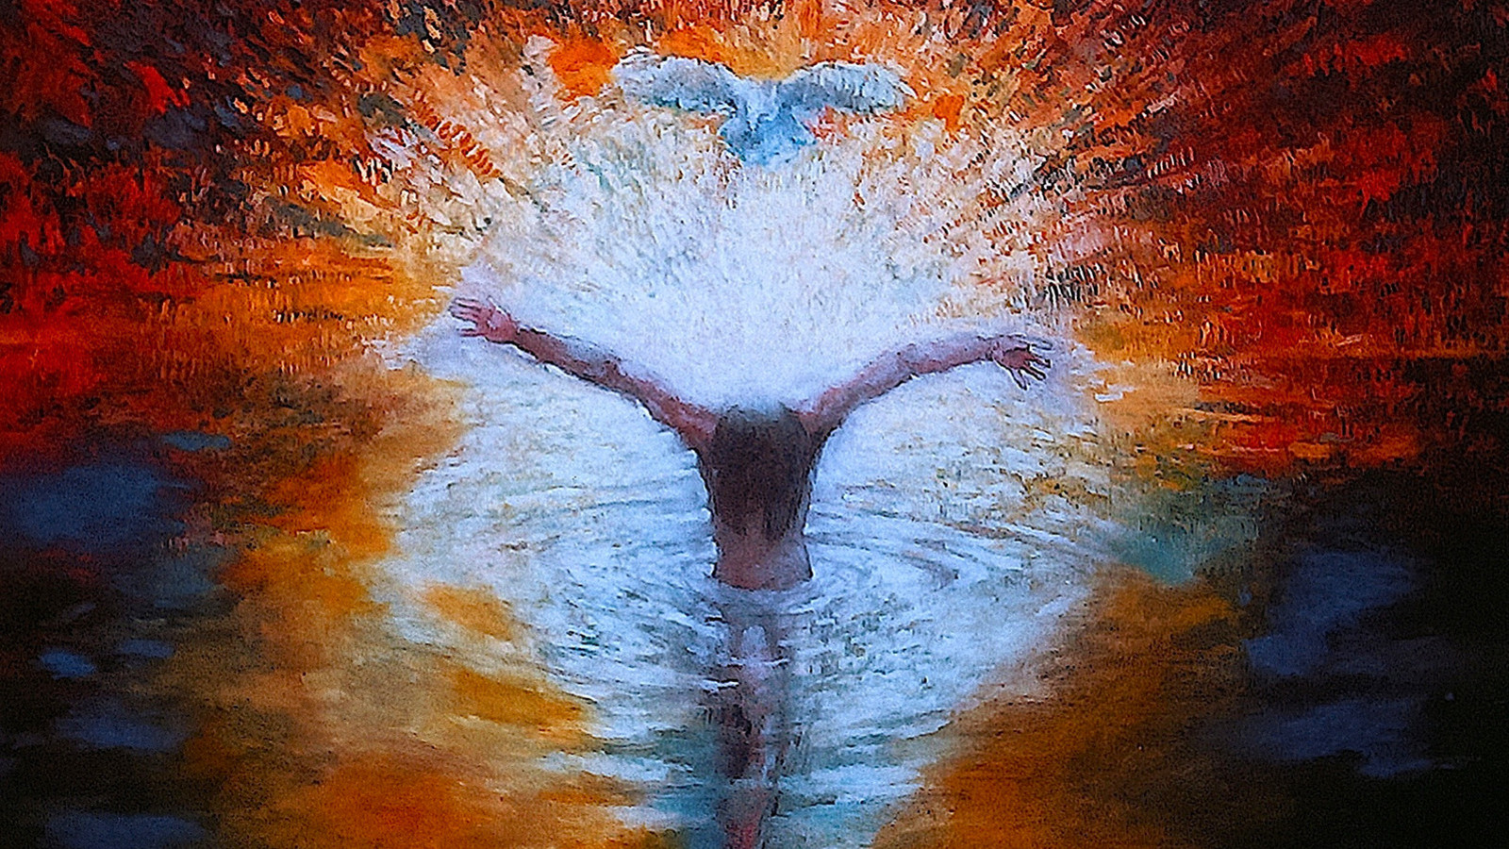
Holy Spirit Descended on Jesus
Holy Spirit as Dove
Hovered over Jesus and New Creation
Right after Baptism

Slide 28
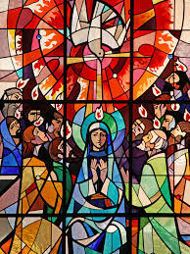
Pentecost
Acts- Ch 2
Holy Spirit Filled the Room (upper room)‏
Holy Spirit is a Person manifested through
Wind
Fire
Dove at Baptism

Slide 29
The Seven Gifts of the Holy Spirit
Spiritual Weapons in the Catholic/Christian’s Arsenal...
Fear of the Lord
Piety
Knowledge
Fortitude
Counsel
Understanding
Wisdom

Slide 30
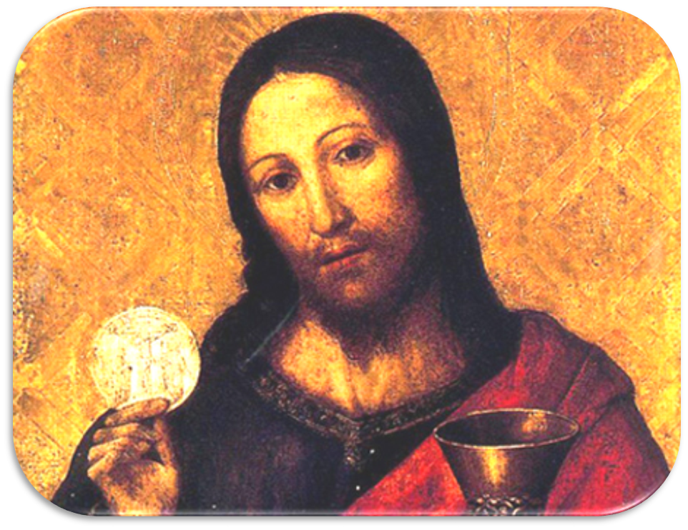
Eucharist

Slide 31
The names
Eucharist-Thanksgiving
Mass- Latin Missa-Dismissed.
Liturgy-Public worship.
Blessed Sacrament-unique presence, most important, sacrifice as essential worship
Communion-the spiritual effect is emphasized
To 'say', To 'hear', to 'celebrate', to 'offer' Mass.

Slide 32
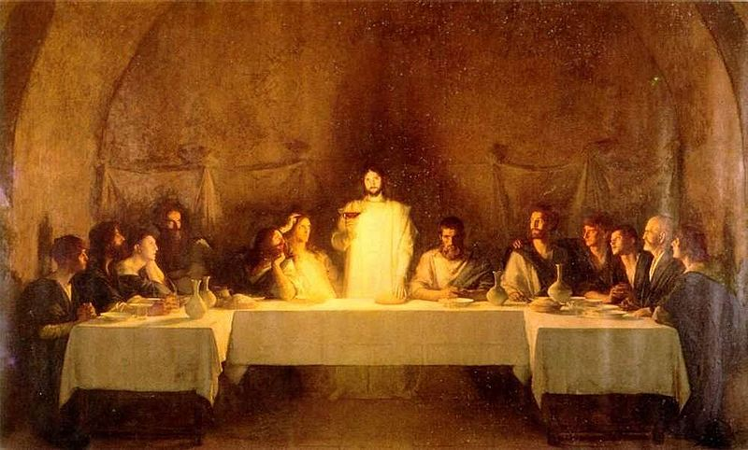
Minister
Priest- The primary function of the Biblical priest was to offer sacrifice.
The Mass is a sacrificial offering therefore it is 'offered' by a priest or bishop.
The priest acts En Persona Christi at Mass in a unique way- during the words of the Last Supper he becomes part of the sign.

Slide 33
Matter
Unleavened Bread-Wine
What kind of bread must be used to celebrate the Eucharist? The bread used to celebrate the Eucharist must be made only of wheat flour and water. Nothing else may be substituted or added. (1412)
What kind of wine must be used to celebrate the Eucharist? Pure, natural grape wine must be used to celebrate the Eucharist. Such wine, made for sacramental purposes, should be clearly designated as altar wine. (1412)
Bread is a staple diet-universal food. Wine is also universal
Out of many come one, grains, grapes
Sacrificial-the work of human hands. Both crushed and reconfigured
Passover

Slide 34
Form
Eucharistic Prayer
The Words of the Last Supper
The words of Consecration ,
“This is my Body, This is my Blood”

Slide 35
Effect and Fruits CCC 1391-1401
Unseen reality-”Real Presence” bread and wine changed into B.B.S.D. Of Jesus.
The Eucharist brings about unity
With Christ-”I am in you and you are in me”(Communion)
Marital-Church as spouse as bride receives His body
Unity with each other as the Body of Christ, “Though we are many we are one body in Christ”
Forgiveness of Venial sins
Strengthens individual, and bond of Church-Nourishment

Slide 36
Proper Disposition
To receive one must be...
Baptized Catholic
In a state of grace-not aware of any grave sins(Mortal sins) that have not yet been confessed in the sacrament of confession
Fasted for at least one hour before receiving
Prepare oneself through quiet reflection-spiritual openness
Belief-Not just in the Real Presence but in all that the Church teaches. “Amen”.

Slide 37
Eucharist in Scripture
Gn 3: 6 The Tree and fruit of death
Gn 4:4 Abel and his offering
Gn 14:18-20 Melchizedek
Gn 22:1-18 Isaac and Abraham
Ex 7:19-24 Water to Blood
Ex 12: 1-10 Passover Lamb
Ex 24 :8 The Blood of the Covenant
Ex 16:1-8 The Manna and Flesh
Lv 16:15-19 The High Priest and Atonement
Lk 2 The Manger
Lk 24 The Eucharist at Emmaus
Jn 2 The Wedding at Cana
Jn 6 The Multiplication of the Loaves
Jn 6 The Bread of Life Discourse
Mt 26 Institution of the Eucharist at the Last Supper
Acts 2 The Early Church Breaking Bread
1 Cor 10:16 Real Presence “The cup of Blessing…”
1 Cor 11: 27-29 Real Presence “Unworthily”

Slide 38
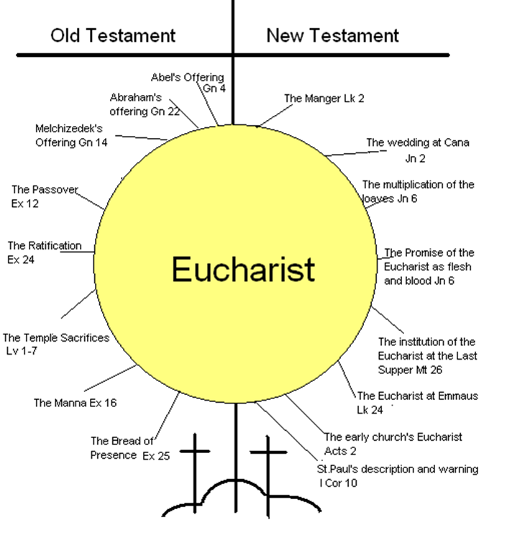

Slide 39
The Mass CCC 1348-1355
Liturgy of Word
Synagogue Root
1.1st Reading
2. Responsorial Psalm
3. *Gospel
4. Homily
Liturgy of Eucharist
Temple Root
Taking (offertory)
*Blessing(Eucharistic Prayer)
Breaking(Fraction Rite)
Giving(Communion)
Prayers of Faithful

