Slide 1
Holy Matrimony and Sexuality
Preliminary Comments
Understanding Love
The Story and the Epic Marriage
Sacrament of Holy Matrimony Parts
Examples and Models of Married Love
Lunch
The Bridge Between Sacraments and Morality
Commandments Six and Nine: God’s Plan for Sexuality
Resources and Strategies

Slide 2
‘My Teaching is not my own’
‘Fidelity to the mission of catechesis requires humility, personal holiness’
‘Whole and entire in all of its rigor and vigor’
‘We propose theological/doctrinal truths not political arguments’
-‘False assignment of political labels’
‘Zealous does not mean overly emotional. Dispassionate, pastoral and calm is no less convincing and credible’
‘We pray for bad people and we fight against their bad ideas’
‘We know we are to be rejected and persecuted-don’t be surprised, don’t be afraid. Don’t apologize, it is an act of mercy’.
‘Mis-Placed Compassion and Real Compassion’
‘Picking at spiritual Scabs: We are all hurt by the breakdown of the family and sexual confusion’
‘Standing in the Truth with Love’
‘Clarity for the sake of Charity’
‘The Talk’

Slide 3
Theology of Love

Slide 4
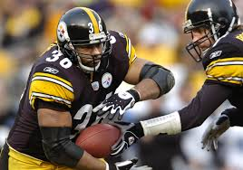
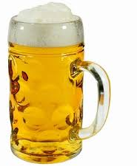
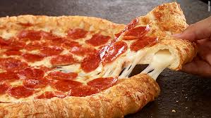
The Problem with the word Love
No word is more misunderstood in our society than the word love...
One word isn't enough...

Slide 5
CCC 1604: The Four Loves
1. philia (friendship).
2. storge (Family love)
3. eros (sexual desire, romantic love).
4. agape(charity) the kind of love Christ taught and showed Sacrificial love.
Natural
Supernatural

Slide 6
Peter and Jesus Jn 21:14-19
Agapao
Jesus asked, “Do you love me?”
Peter responded each time, “Yes Lord you know that I love you!”
Jesus predicts the ‘agapification’ of Peter’s love by saying he would be martyred.
Phileo

Slide 7
Philia
Greeks used as love for friend. Brotherly love (Philadelphia).
Conditional: Reciprocation
Shared interests
Phila- 'love of', delphia-brother
Philosophy, Philanthropy
Used in NT not as much as Agape.
“Yes Lord you know that I love you”(Peter)

Slide 8
Eros
Eros is the love of 'lovers'. Male-Female attraction desire. Intoxicating.
Personal but Conditional: Reciprocation
Eros was the Greek god of love-sensual, sexual, impulsive. Feelings and attraction.
Not used in NT.
Song of Solomon: Eros is legitimate when not degraded and perverted
Prone to false absolutes: sexual desire and emotions

Slide 9
Storge
Storge, familial love, is a word for the bond that exists between one who loves and persons, animals, and the things that surround him.
Natural love of parents, siblings.

Slide 10
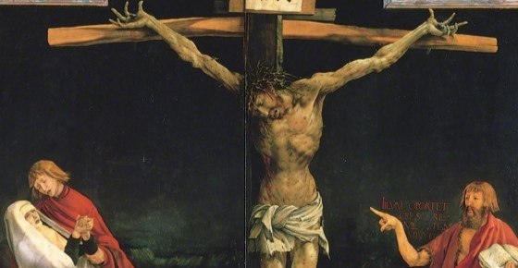
Agape(Charity) CCC 1822-1829, 2093-2094
Most common word for love in NT(“Peter do you love me?”(Jesus)
Christian Love/Heroic Love/Divine Love
Given as a virtue in Baptism (Love/Charity)with Faith and Hope...
“This is my body given for you”-Jesus exemplifies self-sacrificial love, Jesus (Mt 26:26)
Characteristics:
-unconditional
-sacrificial
-unselfish
-unchanging
-active
-antidote to fear

Slide 11
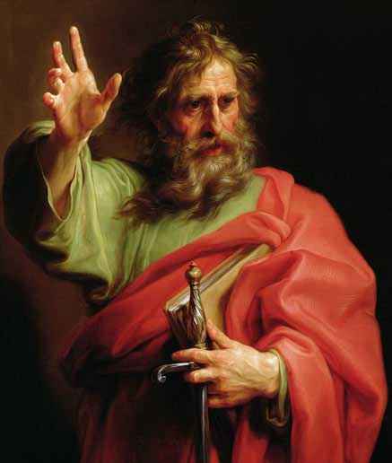
St. Paul’s attributes for Agape…
1 Corinthians 13:4-8
What Agape is… patient & kind.
What Agape is NOT… proud, self- seeking, easily angered.
What Agape does…protects, trusts, hopes. rejoices with
the truth
keeps no record of wrongs & always perseveres.
What Agape does NOT…envy, boast, dishonor
others, delight in evil, fail.

Slide 12
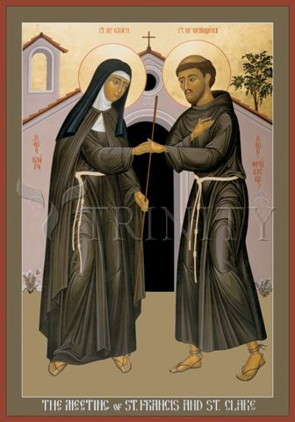
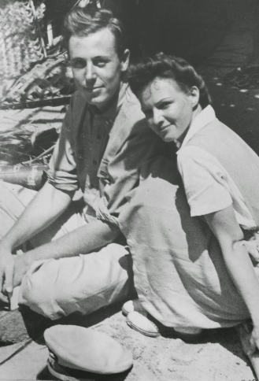
Real Stories of Natural Love Transformed

Slide 13
‘Grace perfects nature’… the ‘agapification’ of natural love
Agape (Charity) upholds and purifies our human ability to love, and raises it to the supernatural perfection of divine love. CCC 1827
This grace proper to the sacrament of Matrimony is intended to perfect the couple's love and to strengthen their indissoluble unity. CCC 1641
‘Agapification’ = upheld, purified, raised and perfected.

Slide 14
-The Fifth Love- Conjugal (Marital) Love
Eros + Philia (grace) = Conjugal Love
Natural romantic love and natural friendship love constantly transformed, in the grace of the sacrament, by supernatural divine love.
When received well and when cooperated with the spiritual effect of the sacrament is like love transformed from ‘water to wine’…
-The covenant of the couple is integrated into God’s covenant with mankind. CCC 1639
-“Authentic married love is caught up into divine love” CCC 1639

Slide 15
Conjugal Love is distinct
What are the distinctive attributes/requirements of Conjugal Love? (CCC1643)
Unity and Indissolubility (marriage bond unbreakable until death)
Fidelity(mirrors God’s faithfulness)
Openness to New Life (procreation and education of the offspring)

Slide 16
How do couples go from ‘Eros/Philia’ to ‘Conjugal Love’
Sexual Attraction
Affectivity and Feelings
Affirmation of The Person
God’s Presence in human Love

Slide 17
Holy Matrimony

Slide 18
Given the current crisis and high failure rate, marriage requires intensive preparation and study.

Slide 19
4 Reasons to Study Holy Matrimony
Over 50 % of marriages end in divorce.
Cultural confusion regarding the nature of marriage.
Most of you have a calling to the Married Life.
Gives meaning and understanding to Sex.

Slide 20
Vocation/Discernment
-All are called/chosen by God to holiness in this life, and eternal beatitude/happiness.
*We evaluate and analyze everything with this end in mind.
-Within this universal call-Some are called to a specific state in life- ‘Holy Matrimony’ ordered or directed to an end (holiness/communion with God in this life and the next).
-Discernment- ‘Is it God’s will for us to enter into the vocation of Holy Matrimony as a means to sanctification?’

Slide 21
CCC 2350 Discernment for Vocation of Matrimony
Be Chaste...
Pray
Confession
Eucharist
Rosary, devotion our Lady, Mary
Study
To be in possession of your self: You can't give what you don't have (maturity, self-control)

Slide 22
Clarity and Terminology
Holy Matrimony:
A sacrament of vocation and service.
Ecclesial Status/New State: This is a radical life-style.
A God-made marital covenant between God and two baptized persons-man and woman where eros (self-centered) love becomes ‘agapified’ (other-centered) through grace.
This marital love known as ‘conjugal love’ is total self-giving: 1.open to life/ ‘life giving’, 2.unbreakable and 3.committed until death.

Slide 23
CCC 1601, 2363 :The purpose of Holy Matrimony
The spouses' union achieves the twofold end of marriage:
1. The good of the spouses themselves. (Personal sanctification)
2. The transmission of life. (Build up the Body of Christ)

Slide 24
Other ‘Marriages’
Civil ‘Marriage’- A man-made contract between any two people recognized by the government. It is indifferent to God or religion. It can be broken at any time for any reason. It is not concerned with procreation or family.
CCC 1603:‘Natural Marriage’- A civil marriage between a man and a woman. It may be a religious, it may be open to life, it may be faithful and it may be until death but it is not a sacrament. It is operating on ‘natural love’.

Slide 25
CCC1602,1611,1617:The whole Story of the Bible is about a Marital/Familial Covenant that grows.
In the Old Testament Israel and the Father have a marital covenant.
Infidelity of Israel= False gods.
In the New Testament Jesus enters into covenant with the Church as a marital covenant. The Church as bride of Christ (Eph 5). Also in Rev 19: Wedding feast of the Lamb. Jesus models true Matrimony as groom to Church.
-This New covenant is indissoluble. God is on both sides human and divine. Sealed with the blood of Christ.
He becomes One Body with the Church=Like Adam and Eve: one body = indissoluble.

Slide 26
CCC 1605:Phase One: Marriage as a Sacred Covenant, Adam and Eve- Gn 2:18-25
Gn 2: Matrimony is a God-given gift to mankind. Adam and Eve have to “prototype” matrimony, blue-print of what God gave to man-kind.
God-given union
Indissoluble-The two become One body Gn 2:24.
Blue-print for ‘Holy Matrimony’

Slide 27
CCC 1606-08, Phase Two: ‘Disordered’…post Fall, O.T. times/modern-day ‘civil marriage’
Marriage fell with Adam and Eve.
Gn 3:7 compared to Gn 2:25
They were naked with shame a sign of a lack of innocence, purity, understanding, trust.
As a result marriage in the Old Testament was in a fallen, degraded state…
A sign of this is acceptable divorce/re-marriage and Polygamy, contract.

Slide 28
CCC 1512-16, Phase Three: Marriage restored and renewed
Through his actions and words Christ
redeemed matrimony.
Mt 19: Jesus’ teaching of indissolubility.
In Mt 19:1-9, Christ discusses phase one as the God-given prototype or blue-print for Holy Matrimony, he discusses phase two(Moses allowed divorce etc.) and he instituted phase three –Holy Matrimony.
-Jn 2: Wedding at Cana: Jesus performs 1st miracle at a wedding –The change of water to wine symbolizes the change of marriage to Matrimony. Water to wine =contract to covenant

Slide 29
Phase 3: Holy Matrimony
God
Baptism
Agape
Agape
Baptism
‘Conjugal Love’
Matrimony
Groom
Bride

Slide 30
CCC 1622-1624: Celebration Parts
Minister = Spouses
Form = Matrimonial Consent: “I DO”
Matter = Consummation (sexual intercourse, “The Marital act”)
Proper Disposition: Baptism, Faith, No impediments. (Marriage Prep, NFP Training, retreat, Confirmation and Reconciliation).
Effect = The two become one. Indissoluble union, grace to desire and raise children in ‘domestic church’, stay faithful, help each other get to heaven. Eros to become ‘Agapified’ or ‘divinized’, ‘supernaturalized’.

Slide 31
CCC 1625-1632: Valid or Invalid?
Valid Ministers- Both Baptized
One actual Male, One actual Female.
Valid Form (verbal assent-’I do’) vows have three marks…
Freely given Consent to terms
Full Knowledge of conjugal love
Full Intent to live conjugal love
See CCC 1643
Valid Matter: The expression of consent, the marital act. Consummation.

Slide 32
Annulments: Declaration of ‘Nullity’
Does not break apart an indissoluble covenant (Holy Matrimony).
Instead, there never was an indissoluble covenant in God’s eyes. It was invalid from the start.
“The Sacrament didn’t take”.
The spouses, after legal divorce, would be free to Marry in the Church.
Children from an annulled marriage are no less valid.

Slide 33
CCC 1633-37:‘Mixed Marriage’ and ‘Disparity of Cult’
The Church warns of difficulties
Mixed Marriage: is between Catholic and non-Catholic but baptized Christian. (Holy Matrimony)
Disparity of cult: is between Catholic and non-baptized(non-Christian). (Natural Marriage)
One could do this with special permission from the Bishop called ‘dispensation’.
Agreements must be made by both parties…
Promise to remain Catholic.
Raise kids Catholic.

Slide 34
CCC 1652-54: Openness to life
The Marital Union: Life giving love
Language of permanence, indissolubility as a foundation for a family
“Let the children come to me”. Mt 19
“Be fruitful and multiply”. Gn 2
Sexual union must always be open to life in cooperation with our natures. Natural: no artificial barriers to life I.e. contraception.
NFP: Natural Family Planning. A method of spacing children without using artificial contraception.

Slide 35
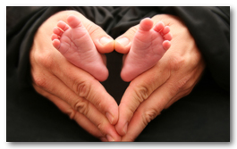
Children: Gift of Marriage: Domestic Church CCC 1655-58, 2373-2379
A child is not something owed to one, but is a gift. The "supreme gift of marriage" is a human person.
A Blessing not a curse/burden.

Slide 36
Commandments Six and Nine Human Sexuality

Slide 37
Commandments Six and Nine
Comes after Love and Matrimony.
Comes right after Commandment Five.
‘Bella’
Comes in Springtime.
Students know me, I care. I dismantled Misconceptions about Catholics.
Prom
Comes after Textbook and ‘Romance Without Regret’

Slide 38
CCC 2521-2525:‘Beautiful or Hot’ -Image 1-
Most comments about Image 1 were about the whole person….
‘Beautiful’ is not about how much sexual desire she generates its about how much respect she generates.
Her sexuality is there but not in your face or flaunted.
Modesty is about the whole person being attractive. There is a deeper mystery in her.

Slide 39
CCC 2339, 2520: ‘Beautiful or Hot’ -Image 2-
Most Comments about image 2 were about her body.
‘Hot’ is a refers to how much sexual desire/lust she generates.
An immediate judgment is made on how valuable she is based on sexuality.
We surrender our imagination to her power.
Challenge for us: To see her as a whole person. Potentially beautiful.

Slide 40
CCC 362-368 Whole Person: Seen and Unseen
Human Beings are composed of a body and a soul. Seen and unseen.
Soul: Intellect, Emotions, Character, Life Story, Family, Friends, Sense of Humor, Interesting

Slide 41
CCC 2342-45: A collection of Body Parts?
Guys are very visual: We make immediate judgments based on the appearance of women
Is she a whole person (beautiful) or only an image that generates sexual desire(hot)?
Utilitarian (‘Throw-Away’ Dimension to “Hotness”: The person is either useful or not in creating sexual interest(lust). Commodity of the Body.
Our Culture: Women who create no sexual desire are ‘Obsolete’. Girls sense this and therefore try to be relevant and useful---through immodesty.

Slide 42
John 8:4-11

Slide 43
CCC 2517-2519: Jesus Image of Women with Bad Reputation
Jesus saw her as…
A whole person
Child/Daughter of God
Worthy of Salvation: Worth dying for.
She was grateful, faithful, hospitable, sorrowful, humble, honest

Slide 44
“There is no dignity when the human dimension is eliminated from the person. In short, the problem with pornography is not that it shows too much of the person, but that it shows far too little.”
― Pope John Paul II

Slide 45
Discussion Q’s
1.What are some of the biological challenges men have to overcome to view women was whole people?
2.In your life, which female person that you interact with and have a relationship with do you most admire?
3.What three characteristics make that person valuable to you? Three things you like about the person.

Slide 46
4. How would Jesus view the image 2 person?
5. How does Jesus’ view compare to how I viewed her?
6. What does John Paul II mean in his quote on pornography? Explain it.
7. What can I do differently to see all females as ‘whole people’?
8. How does Pope Francis’ homily on the women caught in adultery relate to this message?

Slide 47
CCC 2346-47: Our Image of Women we admire…
“Real Women”: Women or females that we interact with and have relationships with.
84%-mom, 4%-sister, 6%-friend, 6%-relative
Welcoming, Caring, Motivational, Loving, Supportive, friendly, Compassionate, kind, motherly, honest, pure heart, loyal, funny, non-judgmental, humble, selfless adventurous, determined, happy-joyful, hard working

Slide 48
CCC 2354, Matt Fradd: 10 Myths of Pornography -Three Junior classes polled in 2016-
Relevant? 88% said ‘Yes’
Realistic? 87% said ‘Yes’
Too Preachy? 84% said ‘No’
Funny? 90% said ‘Yes’
Surprising? 50% said ‘Yes’/’No’
Personally Challenging? 51% said ‘Yes’

Slide 49
"Let the greatest sinners place their trust in My mercy. They have the right before others to trust in the abyss of My mercy.” (Diary, 1146)

Slide 50
CCC 2526-27 :Current Situation in Our Culture: How did we get here?
1950’s: Widespread availability of ‘the Pill’ 1957 FDA approval
1960’s Sexual Revolution
1963-65 Vatican II- Re-affirmed Catholic Sexual Ethos
1968: Prophetic Warning of Humanae Vitae (of Human Life)
-Refusal to Heed
-Refusal to Demand
-Contraceptive Mentality
-Sex has became a casual pastime(one night stands etc.)
1973: Abortion on demand, Roe v Wade
1980’s: STD’s break Records, AIDS
1990’s: “The whole world, post-internet, became pornographized”

Slide 51
2007: Smart phones for kids: Our understanding and learning about sex is primarily are through “pornographic training”
2013-2015 U.S. Same-sex marriage Obergefell v. Hodges
2000’s: Family Breakdown: Since 1970, out-of-wedlock birth rates have soared. In 1965, 24 percent of black infants and 3.1 percent of white infants were born to single mothers. By 1990 the rates had risen to 64 percent for black infants, 18 percent for whites. Every year about one million more children are born into fatherless families.
2000’s Gender Chosen by Individual. Canada.
2010’s Religious freedom Threatened/Overt Hostility and intimidation of Christians

Slide 52
Other Offenses Against Chastity/Marriage
Lust 2351
Masturbation 2352
Fornication 2355
Prostitution 2353
Rape 2356
Adultery 2380-81
Divorce 2382-2386
“Whoever causes one of these little ones who believe in me to sin, it would be better for him to have a great millstone hung around his neck and to be drowned in the depths of the sea.” (Mt 18:6)

Slide 53
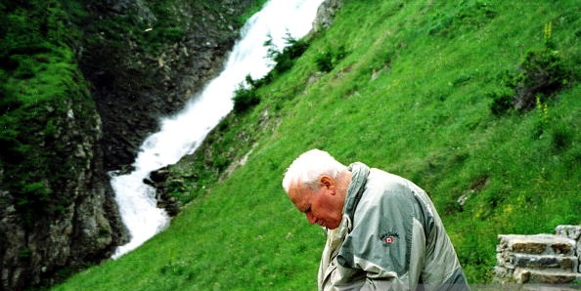

Slide 54
Catholic sexuality teachings in harmony with nature
Natural
Not Natural/Sub-Natural
Desire for Intimacy-to be with a real person. Desire for love and happiness
Fidelity/Chastity: Mental, spiritual, psychological and physical Health
Marriage before sex. Sex implies life-long commitment
Pregnancy (Natural Family Planning-NFP)
Male and Female –creates new life (family).Open to life.
Birth
Acceptance of gender and sexual identity that nature has assigned-
That God has gifted.
Sex with a spouse
Flooded with pornographic culture. Unnatural imagery. Slavery-addiction.
Promiscuity/Sexual Disease-Malfunction
Pre-marital sex, serial polygamy-divorce
Sterilization, pills/chemicals, surgery, condoms
Same-sex is not open to life. Unhealthy.
Abortion (Methods)
Mutilation of bodies, castration surgical implants-sex change
Sex with robots, ’toys’ artificial

Slide 55
CCC 2357-2359 Chastity and Homosexuality
Homosexuality: Formal term used by CCC.
Gay: Informal term given by culture.
Separation of person, inclination and act.
-The Person: A child of God, called to holiness.
-The Inclination: Not a choice. Not a sin. A trial due to concupiscence-fallen nature. Disordered?
-The Act: Serious violation of God’s plan and God’s will-personal sanctification, building up Body of Christ, building up society.
-The Lies- “The Church hates gays”. “Telling same-sex attracted people that they are called to chastity is mean”.
-The Truth-”They must be accepted with respect, compassion and sensitivity. Every sign of unjust discrimination…should be avoided”.-CCC 2358

Slide 56
CCC 372, 2333-2355 Sexual Complimentarity is Natural and Divine vs ‘Gender Ideology’
Lies, Sanity and Truth
Objective Reality vs. Subjective
Biological Reality characteristics. Pregnancy is the natural end of sex.
Natural characteristics of masculine and feminine. Neurological.
Social/Cultural. Gender norms are nature driven.
Having a stable home with a mother and father comes before pregnancy.
Human beings are not free to impose their subjective identity on everyone else. Inconsistent with logic and common good.

Slide 57
Eight common sense rules for peace in a crazy world…
Acknowledge God.
Seek God’s help(grace) and try to do His will.
Respect People’s innate dignity as whole people.
Choose to refrain from sex before *Marriage/Outside of.
Be Fruitful and Multiply in accord with nature.
Stay Married in good times and bad. Eros/Agape.
Raise children Mother & Father complimentary roles.
A family that prays together stays together.

Slide 58
Prayer of Saint Claude de la Colombiere - A Despair Prayer.
Lord, I am in this world to show Your mercy to others.
Other people will glorify You
by making visible the power of Your grace
by their fidelity and constancy to You.
For my part I will glorify You
by making known how good You are to sinners,
that Your mercy is boundless
and that no sinner no matter how great his offences
should have reason to despair of pardon.
If I have grievously offended You, My Redeemer,
let me not offend You even more
by thinking that You are not kind enough to pardon Me.
Amen.

Slide 59
St. Therese of Lisieux on her deathbed…
"Make it clear, Mother, that if I had committed all possible crimes, I would still have the same confidence. I would feel that this multitude of offenses would be like a drop of water cast into a blazing fire. How could there be any limits to my confidence?"

Slide 60
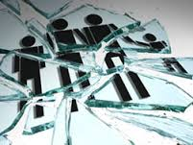
The Consequences of Pornography
Marriage and Family

Slide 61
Mens View Of Women
Pornography...
Is a Drug
Is a form of Sexism
Portrays women in one of 4 degrading, dehumanising categories
Makes men get Bored with their wives
Cultivates a single standard of beauty that no real women can live up to.

Slide 62
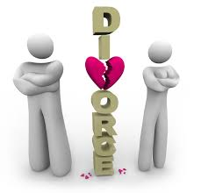
Effect on Relationships
Husbands become less satisfied
Women suffer psych. wounds
Children who encounter their parents’ porn disconnect
Generally reduces interest in family relations
40% of “sex addicts” lose their spouses
58% suffer financial losses
33% lose their jobs

Slide 63
The negative effects
Pornography is compulsive
Greater supply of stimulant diminishes the capacity
The baseline of porn gets raised.
A real naked women is bad porn by today`s standard
orgasms are powerful reinforcers and over time will get associated only with porn
powerful erotic bond between parents is the key to a strong family

Slide 64
Porn Changes A Man’s Performance?
Porn takes away the intensity of sex between an male and female.
Porn is a lot more lonelier, it is less erotically pleasurable because it isn’t face to face.
Porn separates people further apart
By watching too much porn, you will start to not get turned on by just the image of your beautiful wife
It gets rid of the mystery of sex by watching porn
Sex has to be natural you can’t just incorporate such moves and expect for it to go as planned like in porn.
Young men have said that they cannot find a “real women” because of attempting to to learn sex through porn.

Slide 65
Credits
Project done by: Nick Bouch, Brandon Sayegh, Josh De Hesa, Francisco Cuellar
http://www.frc.org/onepagers/the-effects-of-pornography-on-individuals-marriage-family-and-community
http://www.oprah.com/relationships/The-Negative-Effects-of-Porn

