Slide 1
Curriculum, Effective Teaching, Challenges, Course Contents
Who We Are
Our Task
Catechesis in Catholic Schools
The Gospel Message
Evangelization in Catholic Schools
-Lunch-
Challenges
Strategies
The Framework

Slide 2
Who are we?
Religion Teachers/Leading Academic Inquiry
Catechists/Catechizing
Evangelists/Evangelizing
Theologians/Theology
Apologists/Apologetics
Handers/Handing on the Deposit of Faith
Proclaimers/Proclaiming the Gospel Message/Kingdom
Inculturators/Inculturating
Developers/Developing full Christian Faith
Witnesses/Witnessing
GDC: Religious Instructor

Slide 3
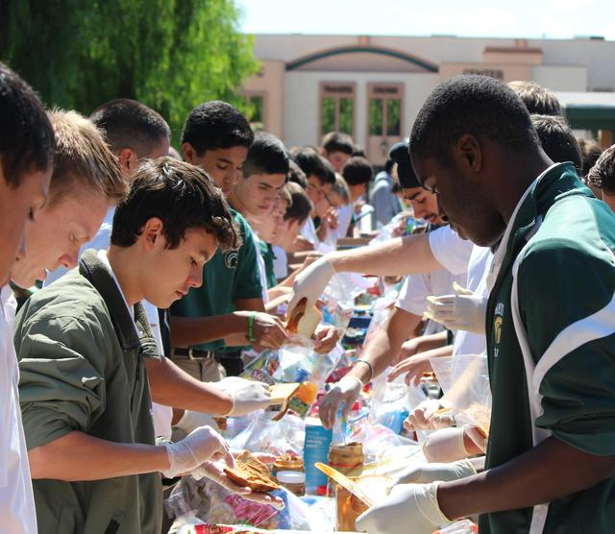
Who are we teaching?
Believers
Searchers
Non-Believers
Jaded Skeptics
Hurt and Confused
Full Spectrum of Academic Ability
“Millenials”

Slide 4
What are we called to do? The four tasks…
  This whole process calls for …
  1. witness to the way of Christ as found in the Scripture and Catholic Church teaching. As teachers
  2. promote knowledge of Scripture and Sacred Tradition, they seek to
  3. create an environment conducive to Christ on campus and in the classroom, and to
  4. impart what will form the students’ foundational understanding of doctrine, moral decision-making, discernment of vocation, forms of worship and service, and involvement in the Christian community of faith
  (ADLA Admin HB 4.3.4).

Slide 5
The Catholic School: ‘Community of Evangelization and Catechesis’
As communities of evangelization and catechesis, Catholic schools impart information and support and encourage formation according to circumstances of place, culture, and times (The Catholic School 1977).
Evangelization most easily occurs when students see and hear the Gospel message through the actions and words of genuinely faith-filled, committed teachers and other students in the school community (To Teach as Jesus Did: A Pastoral Message on Catholic Education; NDC).​

Slide 6
Catechesis

Slide 7
What is ‘catechesis’?
"Catechesis is nothing other than the process of transmitting the Gospel, as the Christian community has received it, understands it, celebrates it, lives it and communicates it in many ways" (General Directory for Catechesis 105).
The name of catechesis was given to the whole of the efforts within the Church to make disciples, to help people to believe that Jesus is the Son of God...and to educate and instruct them in this life and thus build up the Body of Christ (Catechesi Tradendae 1).
Principle source for catechesis “The word of God, contained and transmitted in Sacred Scripture and Sacred Tradition and interpreted by the Magisterium” (NDC 18).

Slide 8
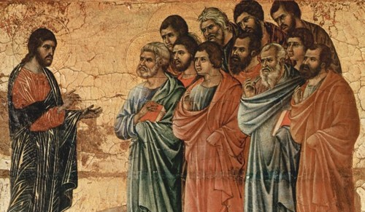
Mt 28:18-20
The Great Commissioning
Full authority has been given to me both in heaven and on earth;
Go, therefore and make disciples of all the nations. Baptize them in the name of the Father, and of the Son, and of the Holy Spirit.
Teach them to carry out everything I have commanded you. And know that I am with you always, until the end of time.

Slide 9
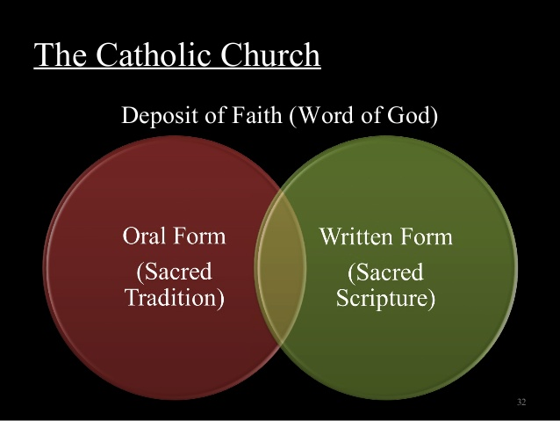
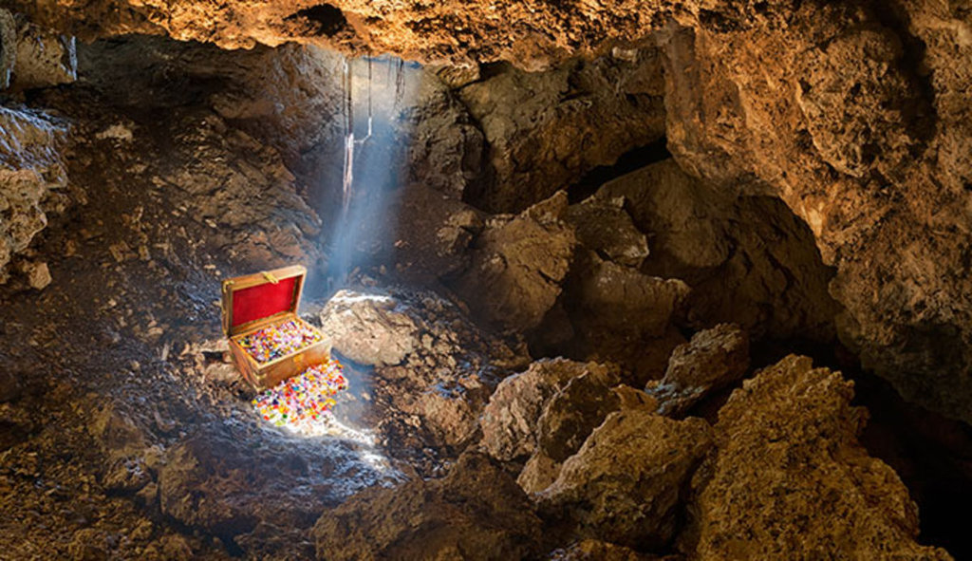
Deposit of Faith: "everything I have commanded you"
The Deposit of Faith is the body of saving truth entrusted by Christ to the Apostles and handed on by them to be preserved and proclaimed. Jesus ordered them to teach the nations and assured them "know that I am with you always, until the end of the world."
(Mt 28:18-20)
Scripture + Tradition = Deposit of Faith
Also Known as ‘The Gospel Message’
The apostles entrusted the "Sacred deposit" of the faith ( depositum fidei), contained in Sacred Scripture and Tradition, to the whole of the Church. -CCC 84

Slide 10
GDC: ‘General Directory for Catechesis’ (1997)
Part 1: Catechesis in the Church’s Mission of Evangelization
Part 2: The Gospel Message
Part 3: The Pedagogy of the Faith
Part 4: Those to be Catechized
Part 5: Catechesis in the Particular Church
Part 2: The Gospel Message
  Chapter 1: Norms and criteria for presenting the Gospel message in catechesis.
  Chapter 2: “This is our faith, this is the faith of the Church”.

Slide 11
NDC: ‘National Directory for Catechesis’ (2005)
Chapter 1: Proclaiming the Gospel in the United States
Chapter 2: Catechesis within the Church’s Mission of Evangelization
Chapter 3: This is our Faith, This is the Faith of the Church
Chapter 4: Divine and Human Methodology
Chapter 5: Catechesis in a Worshiping Community
Chapter 6: Catechesis for life in Christ
Chapter 7: Catechizing the People of God in diverse settings
Chapter 8: Those who catechize
Chapter 9: Organizing catechetical ministry
Chapter 10: Resources for catechesis

Slide 12

“For what I received I passed on to you as of first importance: that Christ died for our sins according to the Scriptures, that He was buried, that He was raised on the third day according to the Scriptures.”
1 Cor 15:3-4
Is Christocentric: Centers on Jesus
Proclaims good news of Salvation/Liberation: Sin and Paschal Mystery
Is Ecclesial: Comes from and leads to the Church
Is Historical: Past, Present, Future
Is For all People/Cultures
Is Guarded by Holy Spirit: Purity and Integrity of Message
Is Comprehensive and Hierarchical
Communicates the profound dignity of human person
(NDC 25)

Slide 13


Historical: Past, Present, Future
"...in time past it began, made progress, and in Christ reached its highest point; in the present time it displays its force and awaits its consummation in the future.”
GDC 107
The Catechetical Narratio

Slide 14
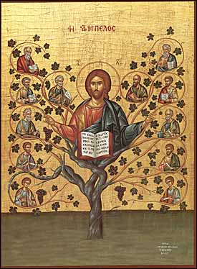
Christocentric
“…at the heart of catechesis we find, in essence, a Person, the Person of Jesus of Nazareth…the definitive aim of catechesis is to put people not only in touch but in communion, in intimacy, with Jesus Christ” CT 5
Trinitarian Dimension Introduced

Slide 15
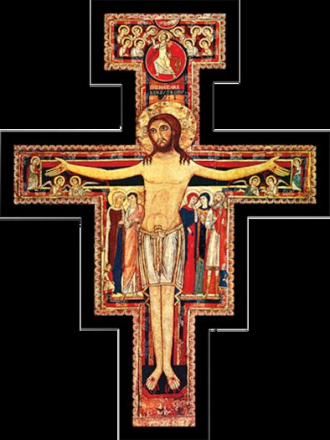
Salvation and Liberation
“This is the great gift of God which is to be considered as comprising not merely liberation from all those things by which man is oppressed, but especially liberation from sin and from the domination of the evil one.”
GDC 101

Slide 16
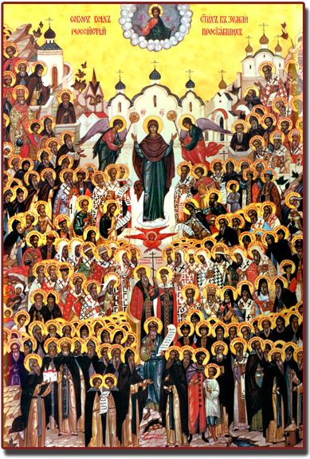
Ecclesial
“When catechesis transmits the mystery of Christ, the faith of the whole people of God echoes in its message throughout the course of history:
  the faith received by the Apostles from Christ himself and under the action of the Holy Spirit
  that of the martyrs who have borne witness to it and still bear witness to it by their blood
  that of the saints who have lived it and live it profoundly
  that of the Fathers and doctors of the Church who have taught it brilliantly
  that of the missionaries who proclaim it incessantly
  that of theologians who help to understand it better; that of pastors who conserve it with zeal and love and who interpret it authentically.
  In truth, there is present in catechesis the faith of all those who believe and allow themselves to be guided by the Holy Spirit.” GDC 105

Slide 17


Dignity of the Human Person
“The proclamation of the Gospel shall always be done in close connection with human nature and its aspirations, and will show how the Gospel fully satisfies the human heart.”
GDC 117

Slide 18
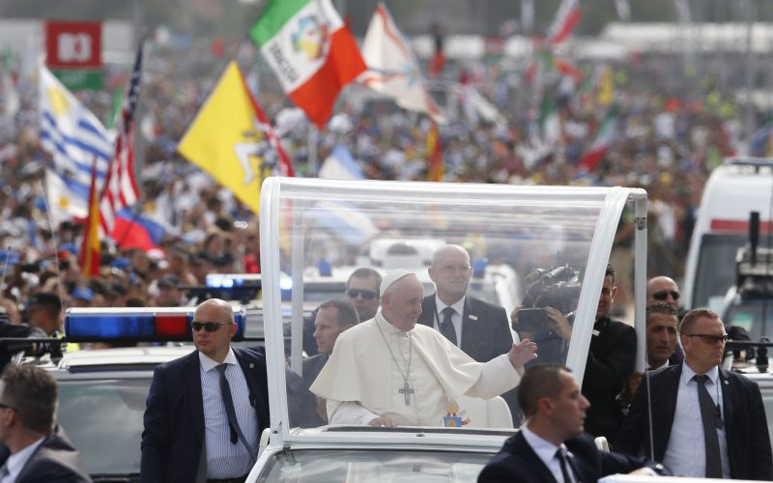
For All People/Cultures
“Presenting the Christian message in such a way as to prepare those who are to proclaim the Gospel to be capable "of giving reasons for their hope" in cultures often pagan or post-Christian: effective apologetics to assist the faith-culture dialogue is indispensable today”.
GDC 110

Slide 19

Comprehensive and Hierarchical
“This message transmitted by catechetics has a ‘comprehensive hierarchical character’, which constitutes a coherent and vital synthesis of the faith. This is organized around the mystery of the Most Holy Trinity, in a christocentric perspective, because this is "the source of all the other mysteries of faith, the light that enlightens them.“ GDC 114

Slide 20
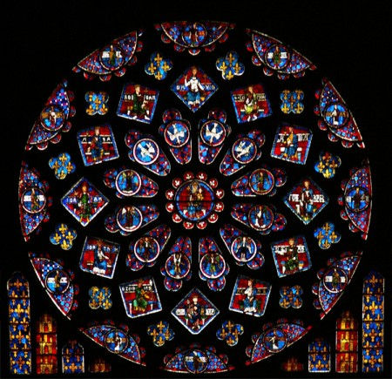
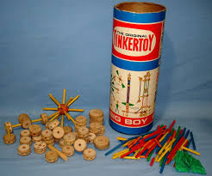
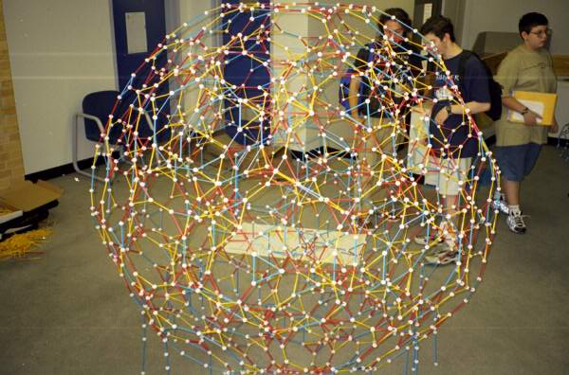
Hierarchy of Truths
The Deposit of Faith is an organic unity.
The doctrines of the Faith are not independent of one another. Often, the teaching of a related doctrine will reveal to a participant what had been previously hidden.
These five foundational truths of revelation are invoked throughout the Catechism and provide a framework in which all doctrine finds its proper context. They are:
The Blessed Trinity: God is an eternal loving communion of Father, Son, and Holy Spirit
The Person of Jesus: A divine person who took on human nature in the Incarnation
The Paschal Mystery: the suffering, death, resurrection, and ascension of Jesus Christ
The Dignity of the Human Person: made in the image and likeness of God
The Church: the Body of Christ brought to life in the Holy Spirit

Slide 21

Purity and Integrity
”…the person who becomes a disciple of Christ has the right to receive "the word of faith" not in mutilated, falsified or diminished form but whole and entire, in all its rigor and vigor. Unfaithfulness on some point to the integrity of the message means a dangerous weakening of catechesis and putting at risk the results that Christ and the ecclesial community have a right to expect from it.”
CT 30

Slide 22
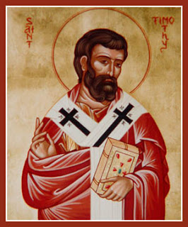
“Guard the Deposit/Guard the Truth”
“O Timothy, guard the deposit entrusted to you. Avoid irreverent chatter and the opposite arguments of so called knowledge which some have professed and thus swerved away from the faith.”
-1 Tim 6:20-21
“Follow the pattern of the sound words which you have heard from me, in the faith and love which are in Christ Jesus; guard the truth that has been entrusted to you by the Holy Spirit who dwells within us.”
-2 Tim 1:13-14

Slide 23

Mt 18:6
The Millstone
“If anyone causes one of these little ones—those who believe in me—to stumble, it would be better for them to have a large millstone hung around their neck and to be drowned in the depths of the sea”. -Jesus

Slide 24
“Formulations of Gospel Message Over the Centuries”
Kergma
Scripture
Didache
Creeds/Professions of faith
Early Father’ Commentaries/Homilies
Liturgical formulas
Eucharistic prayers
Local catechisms
Doctors/Saints
Church Council Docs
____________________
Universal Catechism (CCC)
CCC-Sure Norm for Teaching The Faith: Used for formation of Local Catechisms, Textbooks, Lesson Plans
-----------------------------------
Other helps, manuals and guides…
Church Docs (See chart)
GDC
NDC
Doctrinal Framework
ADLA Administration Handbook

Slide 25









Threads and Pillars of the CCC

Slide 26
Evangelization

Slide 27
New Evangelization
“The activity of a Catholic school is, above all else, an activity that shares in the evangelizing mission of the Church” RDE 101
“The New Evangelization is the old evangelization: Declaring the Lordship of Jesus Christ” Bishop Barron
What’s new about it?
  Ardor
  Expression
  Methods

Slide 28

New Ardor
Ardor = To Burn
The apostles were on fire and it came from clarity about the Resurrection of Jesus Christ from the dead.
They were the ultimate ‘Witnesses’ full of contagious zeal.

Slide 29
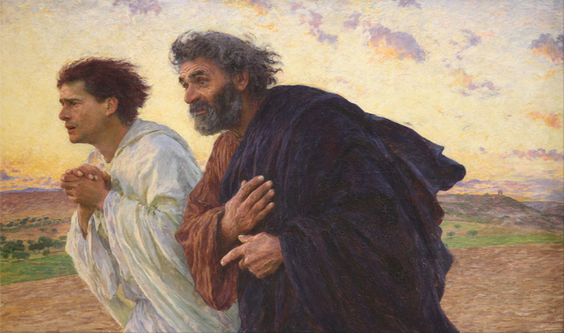
1 John 1:1-3 Zeal of the Catechist
…what we have heard, what we have seen with our eyes, what we looked upon and touched with our hands concerns the Word of life—
for the life was made visible; we have seen it and testify to it and proclaim to you the eternal life that was with the Father and was made visible to us—
what we have seen and heard we proclaim now to you, so that you too may have fellowship with us; for our fellowship is with the Father and with his Son, Jesus Christ.

Slide 30
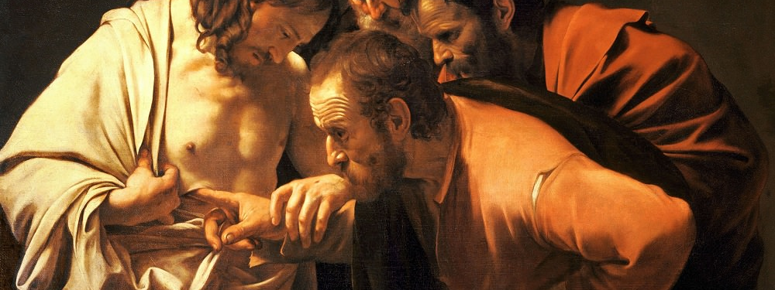
It’s True!
“Tradition is not the worship of ashes, but the preservation of fire.” Gustav Mahler

Slide 31
Challenges

Slide 32
New Forms of Expression
Rejects a watered down, vanilla approach (often found in text books).
Realizes that the culture has changed, is constantly in flux.
Starts with asking, “What’s blocking the message, the Good News from transforming people of today, in this culture?”
  1. Dictatorship of Relativism
  2. Disenchanted World
  3. God is seen as posing a threat

Slide 33
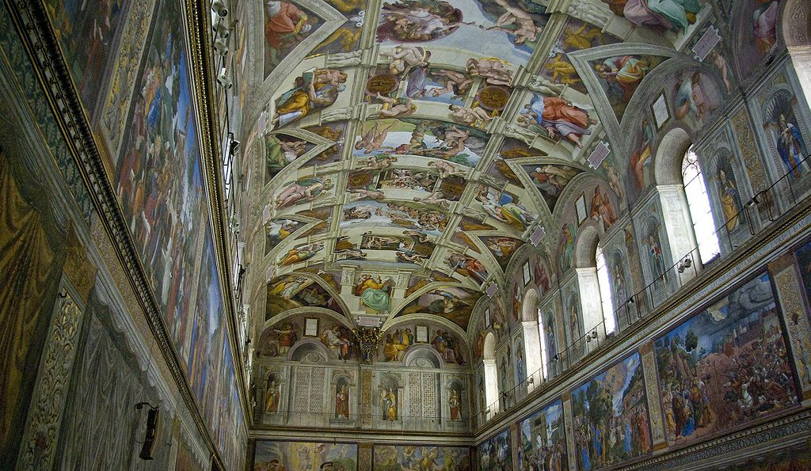
“Meh…Whatever”
“that’s perhaps true for you but not for me” or “who are you to be imposing your values on me?”
“well, that’s just like your opinion”
All meaning is created rather than discovered in nature or in theology.
Fear due to intimidation: ‘Whack-a-mole’: rules for engagement and speech are understood. Immediately labeled and shut down “You’re an …ist”.
Tolerance for the correct way of thinking and speaking. Intolerance for non-conformists (especially Catholic thought).
Loss of a sense of wonder.

Slide 34

The Lost Generation: We must address the Elephant
The ‘Catholic’ Parents and Other Lay Faculty: Generation X is “the lost generation”.
  “Formation” happened in 70’s and 80’s
  You can’t give what you don’t have
  We’ve lost the story and the worldview
  No longer understand ‘the why’ of Catholicism. Relevance.

Slide 35
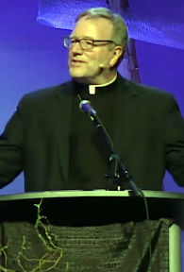
Apologists, Catechists, Theologians: Wake Up!
Presentation by Bishop Barron at ADLA Religious Ed Congress 2016
Crisis: For every new member it gains, the Church loses 6 others. 36% of ‘Young-Millenials’ now identify as ‘Nones’.
There is a serious disconnect. The Faith is not credible. Three problems bugging our young people…
1. Science disproves religion.
2. Religion is just wishful thinking, ‘Fantasy land’.
3. Religion causes more violence.

Slide 36

The Crisis of ‘the NONES’
Our Students: Young-Millenials are becoming the “Nones” at a rapid pace…
  Post Roe v Wade
  Post child sexual abuse scandal
  Post 9/11
  Post aggressive New Atheism
  Post truth, Relativism reigns
  Post-modern means post- narrative: no plot, no meaning
  Post breakdown of marriage and family
  Post Smart Phone
Which religion to belong to?

Slide 37
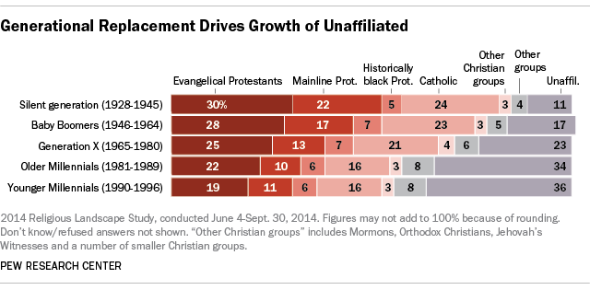

Slide 38
Strategies

Slide 39
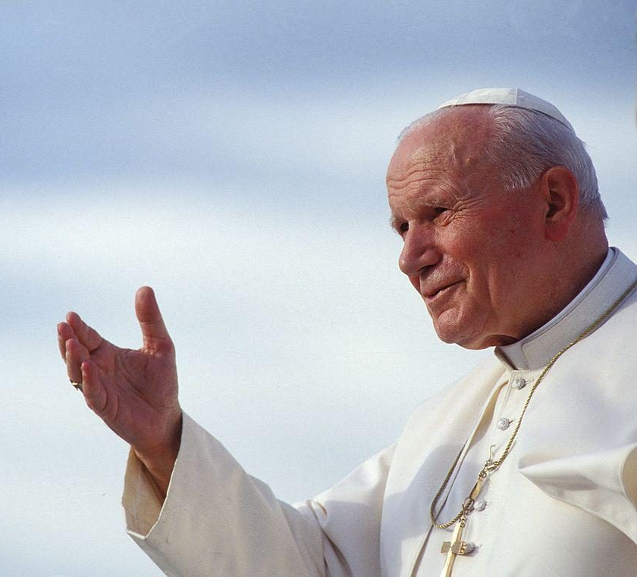
The Transcendentals
"To be young is to be attracted to truth, justice, freedom, peace, beauty and goodness. To be young means being eager to live, but to live joyfully, meaningfully“
(Pope John Paul II, Address to Young People , 1984, Korea).
Truth, Love, Justice, Beauty
Being (Home)

Slide 40
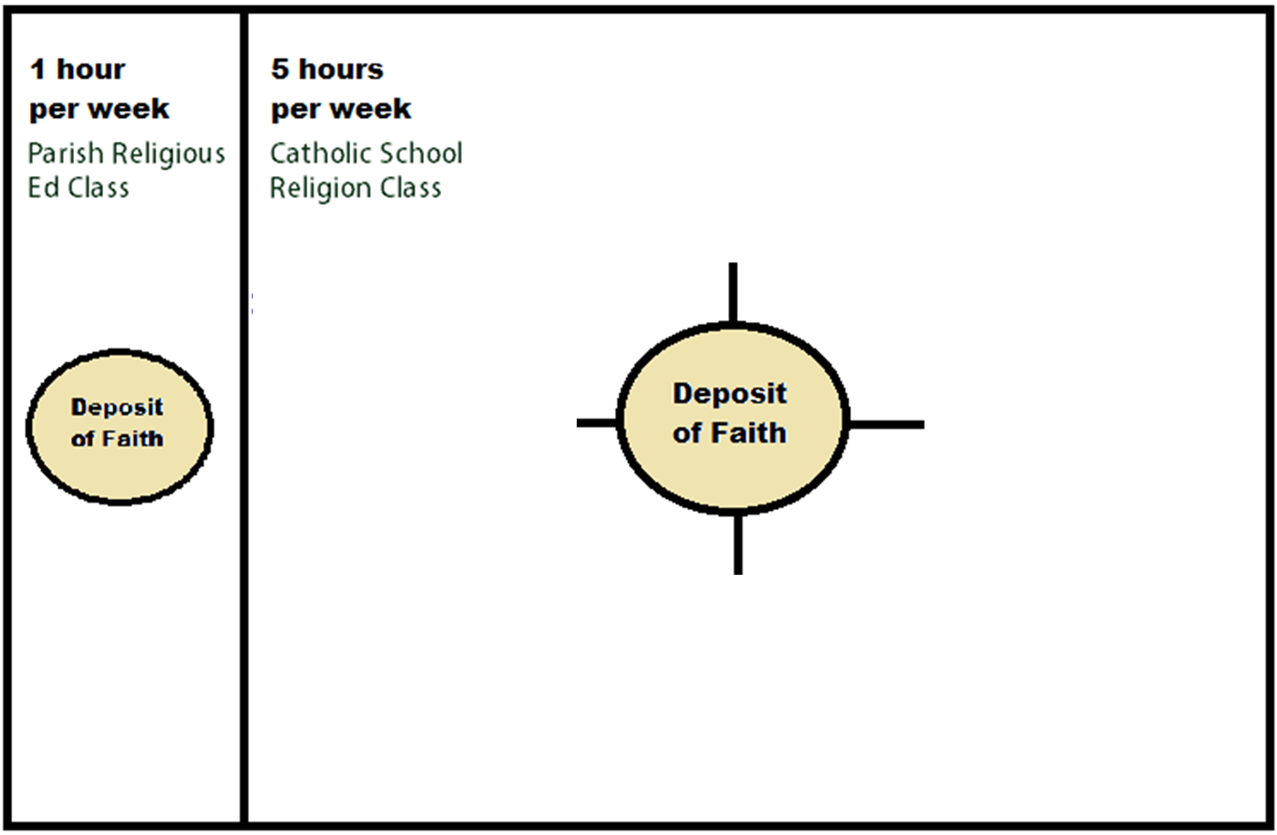
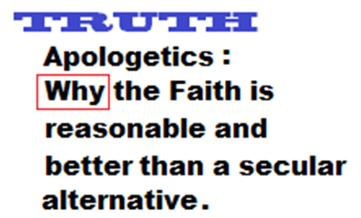
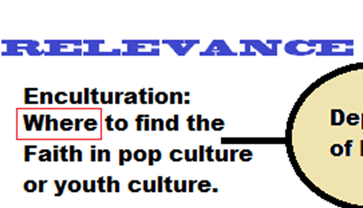
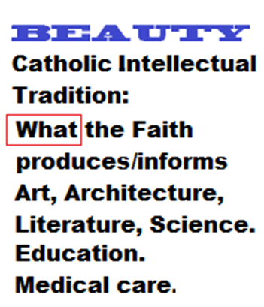


Slide 41
Truth: Apologetics
Conversion stories: Augustine, Francis, CS Lewis, Chesterton, Newman, Scott Hahn, Lea Libresco, Matt Fradd, Chrystalina Evert
Catholic Answers, Magis Center.
Know the ism’s…secularism, materialism, reductionism, post-modernism, relativism, utilitarianism, scientism, new-atheism, hedonism, individualism.
How the ism’s inform the ‘history channel’ version of the Faith.
How to counter the ism’s as a preparation for college classes and culture.
Desire for truth as a proof for the perfection of Truth-God.

Slide 42
Beauty: Catholic Heritage (CIT)
Top Twenties
Patrick Coffin, Roger Scrutton, the Rainbow guy, Dr. Denis McNamara, The Catholic Thing
Catholic Spirit Anthology: Literature, Film, Art
Meditations using Sacred art/images, The Sower, Khan Academy
  Adoration of Magi, Christ in the Desert, OLG, Shroud, San Damiano Cross, Medal of Benedict. Doors, U2, Police, Imagine Dragons, Creed, LifeTeen Music
  Places/Cathedrals etc. Virtual tours and drone imagery.
Music as background timing device to ‘meditation’.
Desire for beauty as a proof for the All-beautiful one-God

Slide 43
Goodness: The True Stories of Good Men and Women
St. Maria Gorretti, St. Damien of Molokai, St. Maximilian Kolbe, St. Therese of Lisieux, St. John Paul II, Francis and Clare, Mother Theresa, St. John Bosco, Fr. Emil Kapaun, Blessed, Charles de Focauld, Blessed Fulton Sheen, St. Oscar Romero.
Michael Monsoor, MLK, Anthony Flew, Former Students, Former teachers & mentors.
Our desire for goodness hints at our desire for the One who is all Good-God.

Slide 44
Relevance: Youth/Pop Culture and Seeds of the Word
Yearbook quotes, lyric assignment, beginning of year questionnaire, discussions
Word on Fire, Church Pop
Seeds of the Gospel by Bishop Barron
Spiderman 3, Last Crusade, Cinderella Man, Deadliest Warrior, Steubenville Conference, LifeTeen
NFL Bios: Chris Spielman, Phillip Rivers, Athletes for Christ
Jason Evert, Matt Fradd, Fr Mike Shmitz
Homeboy Ministries,Hugo and Seaweed

Slide 45
Affective Domain: ‘Faith is Caught not Taught’
School-wide CM
In Class (Block Days)
Intercom prayers before school, before lunch
Liturgy (Monthly, Daily)
Reconciliation
Retreats
Service Learning: Recent Changes
Arts and Crafts
Creative Writing
Guided Group Discussions
Peer Evangelization
Speakers
Meditations
Theoflix
Biographies

Slide 46
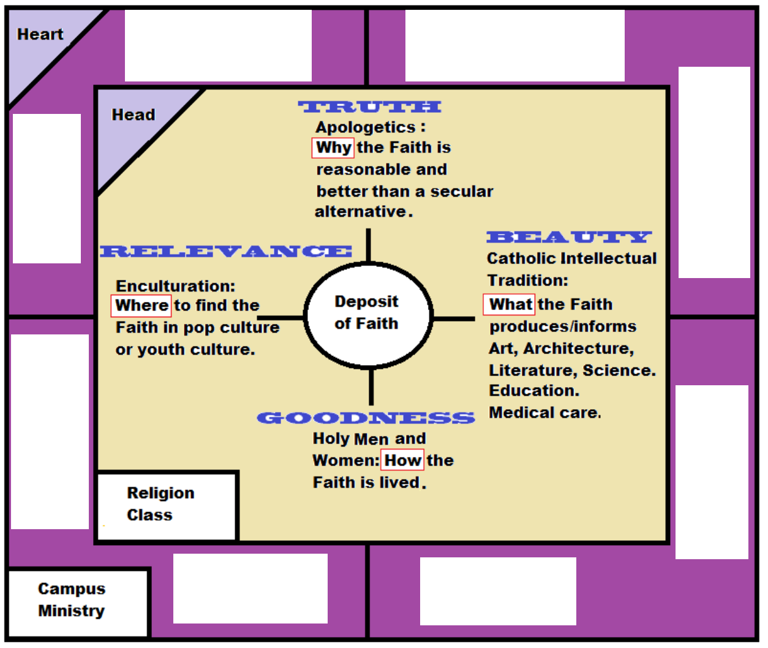












Slide 47
The Framework

Slide 48
Background…
Purpose: To align textbook content to the CCC: The courses were based on the material from the Catechism of the Catholic Church and set up as a framework to allow publishing companies to develop complete, accurate textbooks.
Concerns of the bishops as they responded to perceived religious illiteracy among Catholic high school students in the U.S. due to religion textbooks and, the efforts of publishing companies to respond to the bishops.
The bishops established a conformity review process for religion textbooks in 1996.
Archbishop Daniel Buechlein and Archbishop Alfred Hughes were the first two chairs of the Ad Hoc Committee to Oversee the Use of the Catechism. As they implemented the Protocol, which was used to judge conformity to the Catechism, they found a significant number of texts to be inadequate.
In response to these issues, the committee was developing a scope and sequence. Once the themes for eight semester classes were developed, the committee sent out a document to all the bishops for consultation with high school religion departments and teachers in 2005, followed by a second round of consultations in 2007. This led to the 221-0 vote by the bishops in November of 2007 establishing the Framework. And that is how the Bishops’ Curriculum Framework came to be.

Slide 49
They included ten key points:
1. There is insufficient attention to the Trinity and the Trinitarian structure of Catholic beliefs and teachings.
2. There is an obscured presentation of the centrality of Christ in salvation history and an insufficient emphasis on the divinity of Christ.
3. Another trend is an indistinct treatment of the ecclesial context of Catholic beliefs and magisterial teachings.
4. There is an inadequate sense of a distinctively Christian anthropology.
5. There is a trend that gives insufficient emphasis on God ‘s initiative in the world with a corresponding overemphasis on human action.
6. We have detected an insufficient recognition of the transforming effects of grace.
7. We have found a pattern of inadequate presentation of the sacraments.
8. We have seen a pattern of deficiency in the teaching on original sin and sin in general.
9. We have found a meager exposition of Christian moral life.
10. Finally, we have found an inadequate presentation of eschatology.

Slide 50
It’s about Course Content and Sequence
It is not about methodology.
It is not about affective domain.
It is not about a dialogue with culture(s).
It is not about transcendentals per se.
It is not about the example of Saints.
It is not about classroom procedure.
It is about what students must learn to meet basic criteria and receive principle truths. Fixing the ‘Lost Generation/Nones’ problem.
It does advocate for ‘apologetical’ content in challenge sections.
Sequence is part of the integrity. It’s not accidental.

Slide 51
“The Bishop’s Framework”: Feedback
What is Great
Concerns
Incorporates the Four Threads and Pillars of CCC
Provides a common language of faith
Hierarchy of Truth
Rational for sequence/narrative
Vertical sequencing and spiral sequencing
A whole treatment of Deposit of Faith
Christocentric
Encourages Apologetics
Scripture class leaves out History of Salvation
Repetition as opposed to spiraling
Paschal Mystery as a whole semester
Social Teachings as an elective
Leaves out CIT
Leaves out Saints and Models of Faith
Leaves out affective domain
Not Universal as was intended
Commandments rather than Virtues both/and

Slide 52
Act 1 -The Story: The drama of serpents, sins and promises (Scripture).
Act 2-The Hero/Savior: The promise fulfilled, the hero arrives behind enemy lines to reverse the Enemies’ reign (Christology).
Act 3- The Heroic Act: The ultimate battle that wins the war. Through the great weapon of love the Dragon is doomed, the Maiden set free (Paschal Mystery)
Act 4- The Marital Union: The two become one. Bride as Mystical Body (Ecclesiology)
Act 5- Life-Giving, Transformative Gifts: Grace bestowed upon the bride to be cleansed, nourished, strengthened and made beautiful (Sacraments).
Act 6-The Life Together, Honoring Vows: Terms of the covenant that bear the fruits of virtue, love and happiness (Morality).
Act 7- The Call To Share Their Love: It cannot be contained. A Life given in service to neighbor. “This is my body given for you” (Vocations).

Slide 53
Damien Model of Implementation

Slide 54
Resources
Damien Moodle…Religion…ADLA Certification: Content and Curriculum
Damien Moodle…Religion…‘Theoflix’

