Slide 1
Six Themes

Slide 2
Artifact vs. Relic/Sacramental
Artifact-
Things made by human hands: historical cultural value
Symbolic value (Liberty Bell)
Used to study history/cultures
Facts
Sacramental/Relic-
Material things that have Spiritual significance, oriented to faith
Sign of the sacred
Holy things that convey grace: Chanel/conduit
Used to build faith
Truth

Slide 3
Nazis can’t ‘use’ grail for evil
No because God is the source of supernatural power . He can use material things to transmit that power/grace…BUT God is the Actor not the thing itself.
Ex opera operantis- For a sacrament or a sacramental/relic to be an efficacious(to work) there needs to be cooperation and faith/openness to God’s action.
Motive: Self Gain or Glory of God?
Good can never cooperate with evil: light dispels the dark

Slide 4
Physical contact with the holy
Our Innate desire for God relates to our whole person: Body/Mind/Soul.
Jesus had a body too: Bodies are good/destined for sanctification in this life and transformation in the next.
Sacraments engage us on every level.
Tangible objects help us see BOTH with our bio eyes as well as our eyes of faith. Its not either/or

Slide 5
“Powers you can’t possibly comprehend”
The Grail is a relic/spiritual object but it can’t contain a self-conscious power.
God’s power is always under control by God.
Leads to superstitious and magical thinking with regard to relics/sacramental.
God is in control: Not Occult
Faith is necessary too
Grail Not just a symbol: Symbols are duds that point to external things but don’t contain real meaning

Slide 6
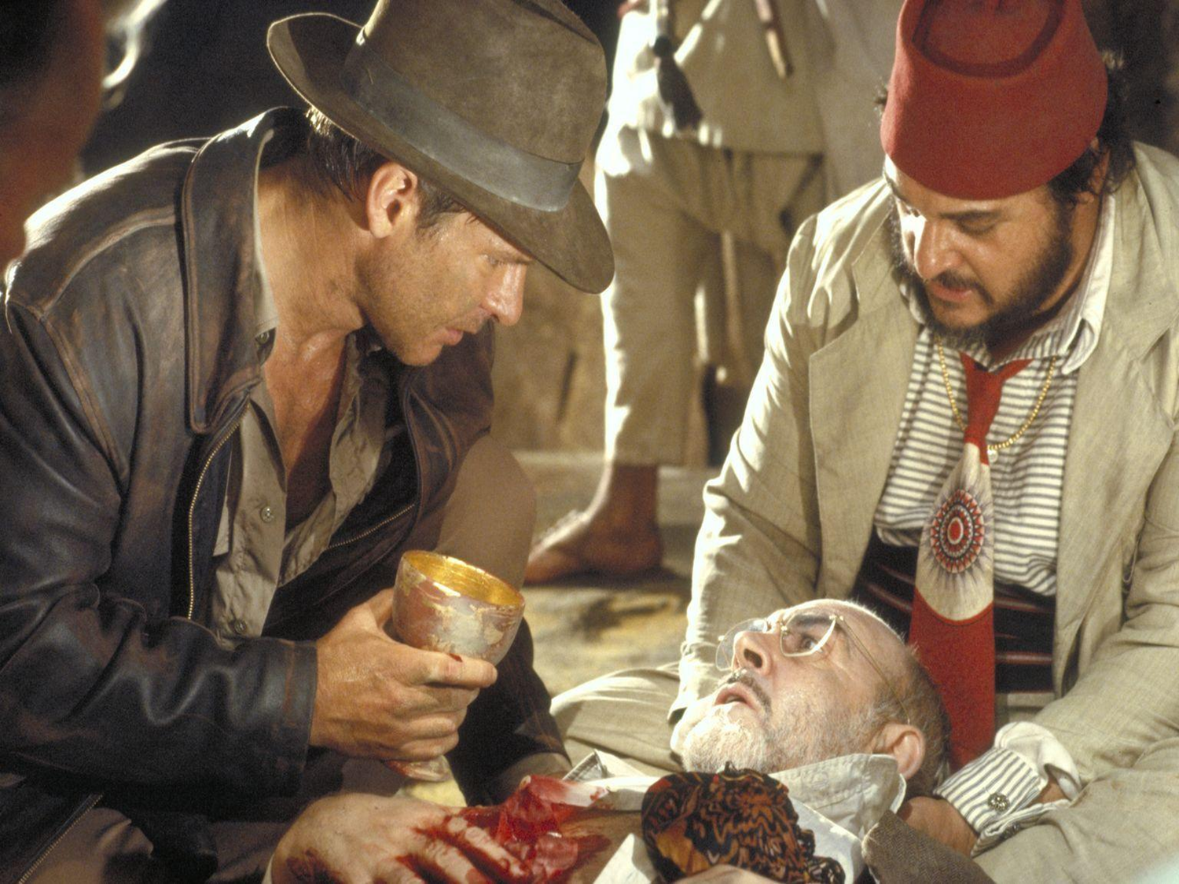
Hollywood v. Catholicism
Cup…………………………..
Magic……………………….
Fountain of Youth…….
-(stuck in a fallen world)
Contents(Eucharist)
Grace given
Divine Life within: Sanctifying Grace is participation in heaven
***Chalice at Mass contains the same thing Grail contained with the same spiritual effect.

Slide 7
Sword wielding Angel guards the ‘Tree of Life’: The Cross and Eucharist
So He drove the man out; and at the east of the garden of Eden He stationed the cherubim and the flaming sword which turned every direction to guard the way to the tree of life. (Genesis 3:24)

Slide 8
Credits
Special Thanks to period 1 (BCE) 2015 for contributions to these notes

