Slide 1
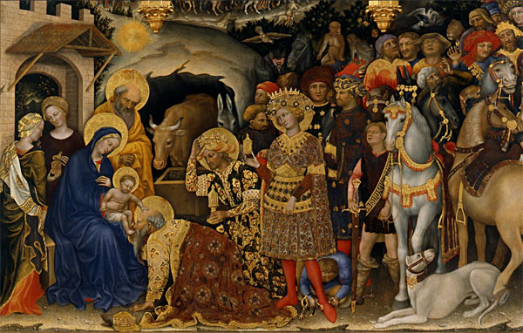

Slide 2
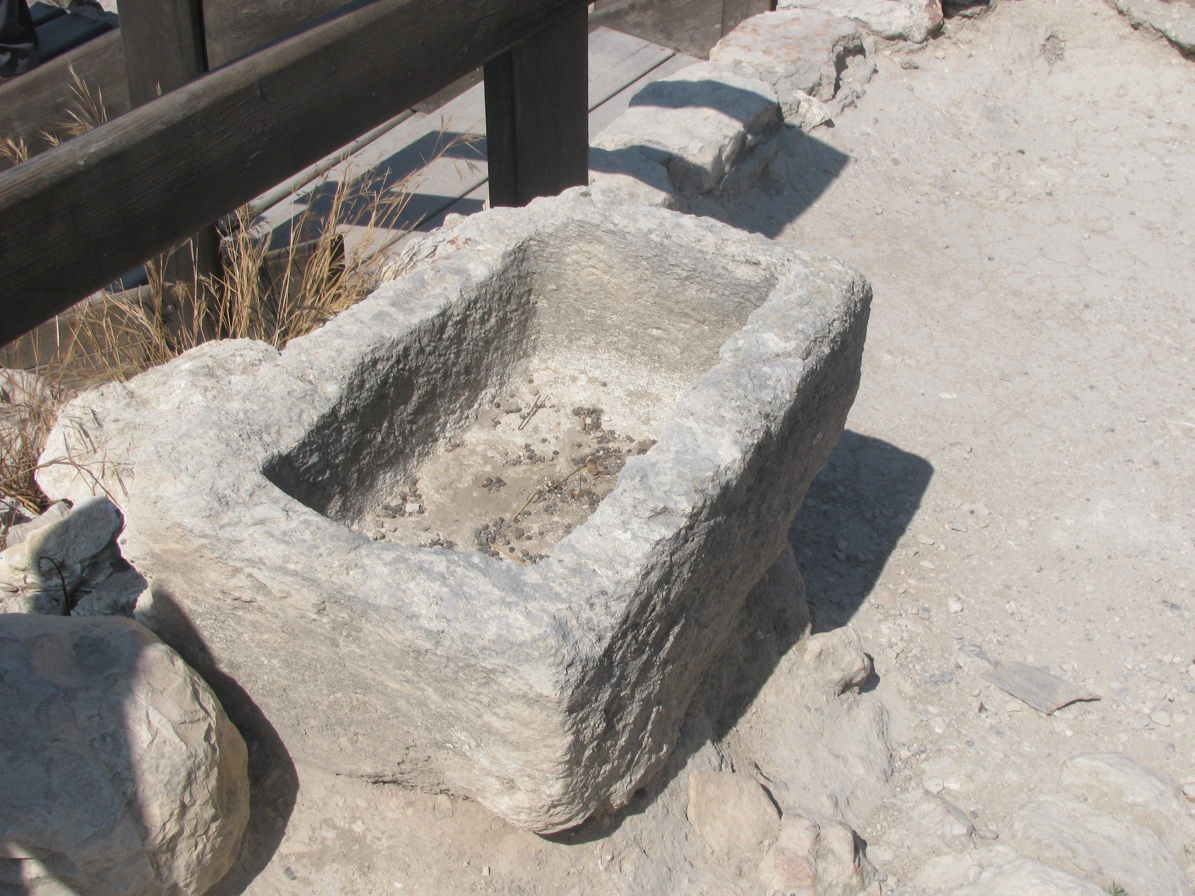
Jn 6: 47-58- “I am the Bread of Life’
Last Supper: Taking Bread, “This is my body”
Bethlehem: Born in the House of Bread
Laid in a Feeding trough

Slide 3
Manger and Eucharist
Universal in Time and Space. The Mass is ‘catholic’: for everyone, every where. “From East to West, the rising of the sun to its setting a perfect offering is made…”
Standing and kneeling as act of worship. Gospel/Communion
The offering of our gifts to God: Offertory from the heart. “We lift up our hearts to the Lord”
Distracted at Mass: lack of eyes of Faith

