Slide 1
Rhetoric

Slide 2
What is rhetoric?
The specific features of texts, written or spoken, that cause them to be meaningful, purposeful, and effective for readers or listeners in a given situation
The art of analyzing all the language choices that writer, speaker, reader, or listener might make in a given situation so that the text becomes meaningful, purposeful, and effective

Slide 3
Furthermore…
Rhetoric enables writers and speakers to design messages for particular audiences and purposes
Language that affects an audience, which informs, moves, delights, and teaches has a rhetorical aim

Slide 4
The Rhetorical Triangle
The Rhetorical Triangle describes the interaction among subject, speaker and audience (or subject, writer and reader), as well as how this interaction determines the structure and language of the argument
Subject
Speaker
Audience

Slide 5
Elements of the Rhetorical Triangle
Subject – writers must first choose a subject and then evaluate what they already know about it, what others have said about it, and what kind of evidence or proof will sufficiently develop their position
Audience: who is being spoken to.
Speaker – the person narrating text
Persona: the character the speaker creates when he or she writes or speak

Slide 6
The 3 Rhetorical Appeals
Ethos – writers appeal to ethos, or character, to demonstrate that they are credible and trustworthy
Pathos – writers appeal to pathos, or emotion, through engaging the emotions of the audience.
Logos – writers appeal to logos, or reason, by offering clear, rational ideas.

Slide 7
Ethos
Appeal to the writer’s/speaker’s believability, qualifications, character; relevant biographical information
Use of credible sources (experts, scholars)
Accurate citation of sources: gives credit where credit is due
Experience and authority: person knows the issues and has experience in the field
Appropriate language: uses language of the discipline
Appropriate tone: knows the audience and context of situation

Slide 8
Pathos
Appeal to the heart/emotion
Draw from spirituality or religious traditions
Stories or testimonials
Personal anecdotes or stories
Personal connections
Imagery and figurative language that provokes an emotional response
Visual images or words that inspire you to empathize or have compassion towards the idea/topic
Powerful words, phrases, or images that stir up emotion
Details that come from subjective reporting

Slide 9
Logos
Appeal to the mind/intellect
Draw from philosophy and logic
Facts
Statistics
If, then… statements
Definitions of terms
Explanation of ideas
Cause and effect
Details that come from objective reporting
Logical reasons and explanations

Slide 19
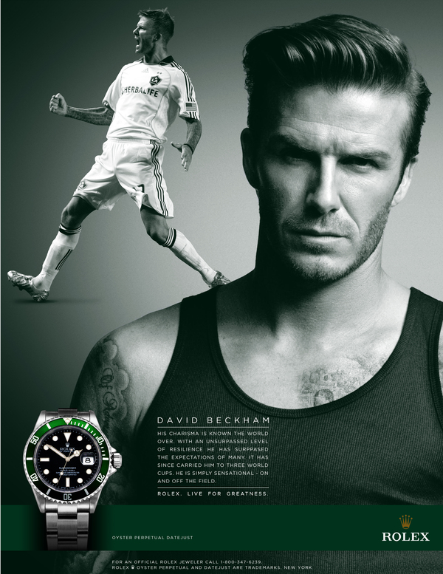

Slide 20
https://www.youtube.com/watch?v=2JnYcuRW_qo
https://www.youtube.com/watch?v=YSbCnWe6e1o

