Slide 1
Works Cited Page

Slide 2
What’s the point?
A works cited page allows your reader to locate the specific book from which your quotes (citations) come from.
It must be in a specific format so that your source is easy to find, no matter who looks at it.

Slide 3
Getting started…
The Works Cited page should be the very last page of your essay.
Should be in MLA format (TNR, DS, 12 p.f.) AND therefore should including the same header as the rest of your essay.
The words Works Cited should be centered, with no underline or italics.
Remember: even this page needs to be double spaced!

Slide 4
Rules
Double space all citations, but do not skip spaces between entries.
Indent the second and subsequent lines of citations by 0.5 inches to create a hanging indent.
All works cited entries end with a period.
Entries are listed alphabetically by the author's last name. Author names are written with the last name first, then the first name, and then the middle name or middle initial when needed

Slide 5
More Rules
Capitalize each word in the titles of articles, books, etc, but do not capitalize articles (the, an), prepositions, or conjunctions unless one is the first word of the title or subtitle: Gone with the Wind, The Art of War, There Is Nothing Left to Lose.
Use italics (instead of underlining) for titles of larger works (books, magazines) and quotation marks for titles of shorter works (poems, articles)

Slide 6
What else?
Book:
Last Name, First Name. Title of Book. City of Publication, Publisher, Publication Date.
Short Story:
Last Name, First Name. Title of Story. City of Publication, Publisher, Publication Date.
Poem:
Author of Poem's Last Name, First Name. "Title of Poem." Title of Book: Subtitle if Any, edited by Editor's First Name Last Name, Edition if given and is not first, Publisher Name often shortened, Year of Publication, pp. Page Numbers of the Poem.

Slide 7
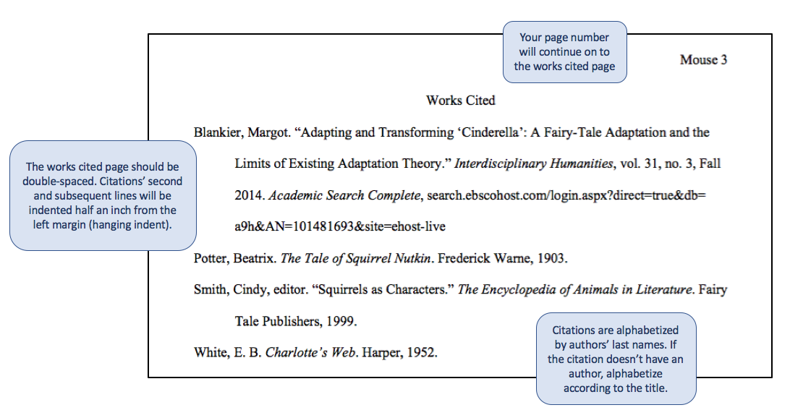

Slide 8
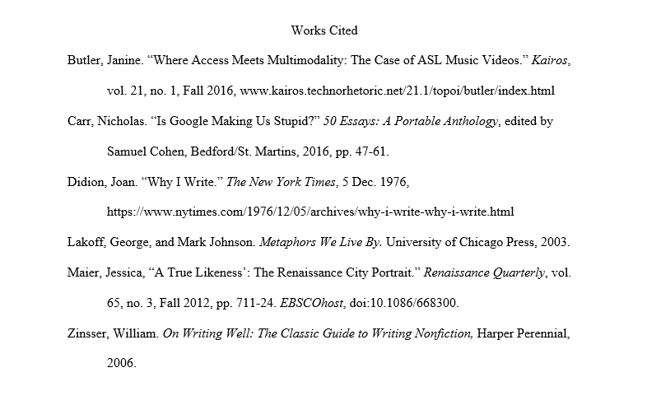

Slide 9
Literary Present Tense

Slide 10
What is it? Why should you use it?
Because literature is immortal/constantly new/living, as writers we must speak about the literature as if it is still happening.
We must use present tense verbs to talk about it.

Slide 11
Examples…
Incorrect: The man tried to build a fire.
Correct: The man tries to build a fire.
Incorrect: Kino went into the mountain to hide from the trackers.
Correct: Kino goes into the mountain to hide from the trackers

Slide 12
Informal Language

Slide 13
What is it? Why we should NOT use it?
Informal language is any word/phrase that creates familiarity between the author and the reader.
Examples: “I”, “we”, “us”, etc.
Formal essay writers (all of you) should not use this because you should never include your reader in your insights and interpretations.

